Slide 1
UNIT 1
BRIEF HISTORY
OF MEDIA

Slide 2
UNIT 1
Introduction to Media
What do I want to learn?
What is my learning objective in this session and the course?
Module 1. Information and Media in a Democratic World

Slide 3
What are we going to do in this session?
define the notions of "media", main media types and formats;
distinguish media eras, what and who stipulated their upheaval;
learn how the media evolution stimulated social changes.

Slide 4
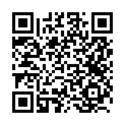
What is media?
how do you understand the word?

Slide 5
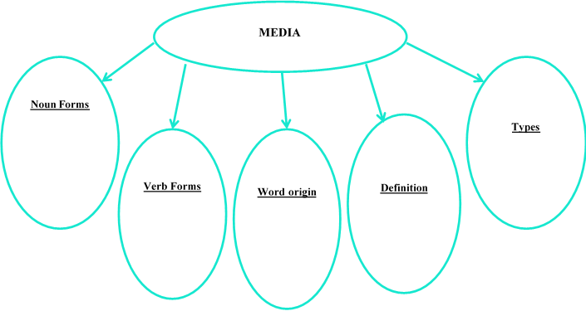
Use Macmillan Dictionary to find all the necessary information
How is the word “media” related to the words “medium”, “mediate”, “middle”?
Which meaning do they share?

Slide 6
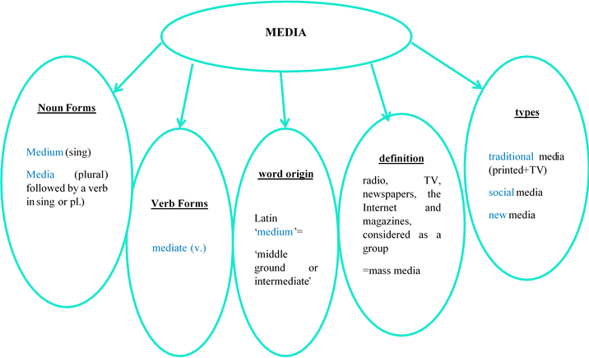
Use Macmillan Dictionary to find all the necessary information
How is the word “media” related to the words “medium”, “mediate”, “middle”?
Which meaning do they share?

Slide 7
1) the printed press, newspapers and magazines, radio, television, and Internet sites that purvey news, information, misinformation, and all shades of opinion;
3) any transmission of information that reaches large numbers of people, usually within a short time frame, in a one-to-many communication flow;
4) tools for the transfer of information, concepts, and ideas to both general and specific audiences;
5) refer to channels of communication that involve transmitting information in some way, shape or form to large numbers of people.
Which of these definitions of mass media do you consider to be the best? Justify your choice.
How often do modern people engage with media in their daily life? Has it always been like that?

Slide 8
What do you know about the evolution of media?

Slide 9
Scan the QR code to visit Encyclopaedia Britannica Online where you can read short articles and/or watch short videos about the inventors of media and find all the information you need.

Slide 10
Who were the people who stimulated the media evolution?
How did they do it?
Name | Invention | Country and year | How did this invention change history and society?
Alexander Graham Bell
Johannes Gutenberg
John Logie Baird
Lumière brothers
Mark Zuckerberg
Philo Taylor Farnsworth
Samuel Morse
Steve Jobs
Tim Berners-Lee

Slide 11
who was the inventor who launched the most radical social changes?
Why
do you think so?

Slide 12
Scan the QR code and study the timeline that describes the evolution of the media

Slide 13
The History and Evolution
of Mass Media
1. What are the four eras of the media? Using the picture, make up 2-3 sentences to characterize every era.
2. How old is the media? Is it older than you used to think?
3. Do you think the media existed before the movable type? In which societies? In which formats (oral, written, graphic)?
4. Analyze the timeline. How did mass media react to the scientific and technical breakthroughs? Give examples.

Slide 14
Watch the video “Brief History of Media” (till 4.20 minutes) by Dan Gilmor (an American technology writer and columnist, director of News Co/Lab, an initiative to elevate news literacy and awareness, at Arizona State University's Walter Cronkite School of Journalism and Mass Communication) which focuses on the evolution of media.
Think of the reasons media was developed and name the main stages of media development.

Slide 15
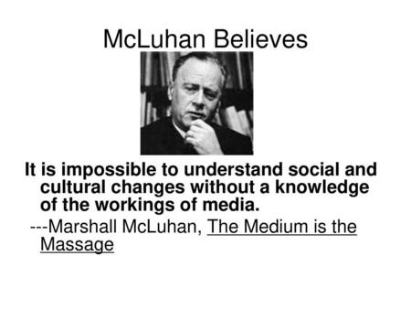
Let’s talk!
How far do you agree or disagree with the following quotation?

Slide 16
What do I already know about the media, its main types and formats?
What do I already know about the media evolution?
Can I distinguish media eras?
Do I know what and who stipulated their upheaval?
Do I know how these inventions changed society?
Was the information useful for me?
What am I planning to do with the new knowledge I have attained during this session?
What did I learn
in this session?

Slide 17
03.09.
To learn more about the evolution of press and television,
do tasks 1-3 + further readings

Slide 18
Good Job!
Types of media: traditional vs new media.

Slide 19
History
of the printed press
Scan the article “A Brief History of Newspaper Lingo” by Angela Tung published in The Week.

Slide 20
Together with your partner fill in the table to find out about the evolution of first reliable system of social information.
Name of the media and / or formats | Time and Place | Format | Other information
Acta Diurna or Daily Acts | Ancient Rome | carved in metal or stone, posted in public places
 | Ancient China
 |  |  | - price of a copper coin
 | 1649
Newspaper
 | 1860s
 | 1908
Yellow journalism
 |  |  | condensed, illustrated, sensational material.
 | 1912
 | 1960s
Factoids
 | UK, 1996

Slide 21
Did you know about all these formats of the printed press?
Which facts came as a surprise for you?
Do/did you have all these formats of printed press in your country?

Slide 22
History of television
1. When and where did television appear?
2. When did it appear in your country and town?
3. What are the most popular TV programs today? Why are they popular?
4. Who are the famous journalists and TV hosts in your county/in the world? How did they change television?

Slide 23
Watch the video “The Evolution of Television: Chapter 1”. While watching, put down the important dates in the history of television. Write out 10 terms connected with television. Check their meaning if necessary.
___________________________________________________________________________________________________________________________________________________________________________________________________________________
Watch the video “The Evolution of Television: Chapter 2”. Write out 10 terms connected with television. Check their meaning if necessary.
________________________________________________________________________________________________________________________________________________________________________________________________________________________
Using the terms, retell the factual history of television. Visit https://www.timetoast.com/timelines/the-timeline-of-tv-s to check the dates on the Evolution of Television timeline

Slide 24
Form and content are closely related in media messages. As Marshall McLuhan noted, each medium has its own grammar and codifies reality in its own particular way. Different media will report the same event, but create different impressions and messages.
Each medium has a unique aesthetic form. Just as we notice the pleasing rhythms of certain pieces of poetry or prose, so we ought to be able to enjoy the pleasing forms and effects of the different media.
Media Literacy top tips

