Slide 2
Elizabethan literature
The English Renaissance

Slide 3
Henry VII – the beginning of the Tudor dynasty
1534 – the Church of England separated from Rome (Henry VIII, England's bluebeard – divorced, beheaded, died, divorced, beheaded, survived)
Lady Jane Grey – the queen of nine day (accused of treason)
1554 – Mary I marries Philip of Spain and reintroduces Roman Catholicism (Bloody Mary, no monuments in England, she executed, beheaded and burnt a lot of protestants)
Elizabeth I – a queen of 45 years the end of the Tudor dynasty
1560 - Reformation established in Scotland
1564 - Death of John Calvin (was at the head of Puritans)
1577-80 Drake's first voyage around the world
1588 – Spanish Armada
1587 - Mary Queen of Scots beheaded, executed for treason, after 19 years of prison. Read a novel about her by St.Tsveig.
James Stuart IV – James I – the union of the Scottish and English crowns the Stuart dynasty.

Slide 4
Great thinkers Erasmus and More
Desiderius Erasmus Roterodamus (1469-1536) humanistic ideas (individual is more important than church and king, man is sinful – man is good with dignity and value, life is sinful – people can enjoy life and so on ), worked in Cambridge as an English professor.
Thomas More (1478-1535) is known for his 1516 book Utopia and for his untimely death in 1535, after refusing to acknowledge King Henry VIII as head of the Church of England. He was canonized by the Catholic Church as a saint in 1935. Utopia covered such far-reaching topics as theories of punishment, state-controlled education, multi-religion societies, divorce, and women's rights, and the resulting display of learning and skill established by More as a foremost humanist. Utopia also became the forerunner of a new literary genre: the utopian romance.

Slide 5
Henry VIII is often described as a true Renaissance Man. He was athletic, good looking, intelligent, well educated and an accomplished musician – played instruments and wrote his own songs. He spoke many languages fluently and loved to read and study. Henry loved art and culture bringing many of the top artists, writers, and philosophers from mainland Europe to his court.

Slide 6
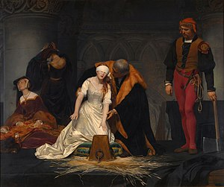
The tragic Lady Jane Grey - the Queen for nine days was imprisoned to the Tower and beheaded

Slide 7
Mary Tudor "Bloody Mary"
Mary Tudor is known as Bloody Mary for her persecution of Protestants in a vain attempt to restore Roman Catholicism in England.

Slide 8
Queen Elizabeth 1

Slide 9
Elizabeth I
Elizabeth I "The Virgin Queen” (1558 – 1603, 45 years as a queen) was a strong protestant. After the death of her sister Mary I in November, 1558, the twenty-five year old Elizabeth, having survived many reversals of fortune, and largely through her own aptitude and skill, ascended the throne.

Slide 10
Mary Stuart, Queen of Scots

Slide 11
In England Mary Stuart became a political pawn in the hands of Queen Elizabeth I and was imprisoned for 19 years in various castles in England. Mary was found to be plotting against Elizabeth I: letters in code from her to others, she was deemed guilty of treason. Mary’s son became James I of England and VI of Scotland after Elizabeth’s death in 1603. Although James would have had no personal memories of his mother, in 1612 he had Mary’s body exhumed from Peterborough and reburied in a place of honour at Westminster Abbey. At the same time he rehoused Queen Elizabeth to a rather less prominent tomb nearby.

Slide 12
Jacob VI / Jacob I

Slide 13
The Elizabethan Era, which is generally considered one of the golden ages in English Literature, was a great boom in literature, particularly in the area of the tragedy. William Shakespeare emerged from this period as a poet and playwright never seen before. Other important playwrights of the era of Elizabeth include Christopher Marlowe, Thomas Dekker, John Fletcher and Francis Beaumont.
Sir Philip Sidney was an English poet, who is also remembered as one of the most prominent figures of the Elizabethan Age. These great people are recognized as the most Famous Playwrights and Authors of Elizabethan period. It was at this time that the city comedy genre developed.

Slide 14
Theater and poetry were the dominant forms of literature during the Elizabethan era. The flourishing of drama revealed the impact the theatre, English people developed a sense of appreciation to plays performance, and very quickly the habit of attending the theater halls rooted in the English culture. During Elizabethan England, the theater became one of the most important places of life, rich and poor alike enjoyed afternoon shows. Conventionally, the poorest spectators got to stand closest to the stage while the rich sat in elevated seats farther back.

Slide 15
The term Sonnet, originated from the Italian sonetto – “little song,” a 14 line lyric poem, was also one of the poetic elements that gained a deep interest in this period. Having composed 145 sonnets, William Shakespeare was widely regarded as one of the best-known “sonneteers,” a name usually attributed to the writers of sonnets. The Shakespearean sonnets are rich and revolve around various themes such as the passage of time, love, beauty and mortality.

Slide 16
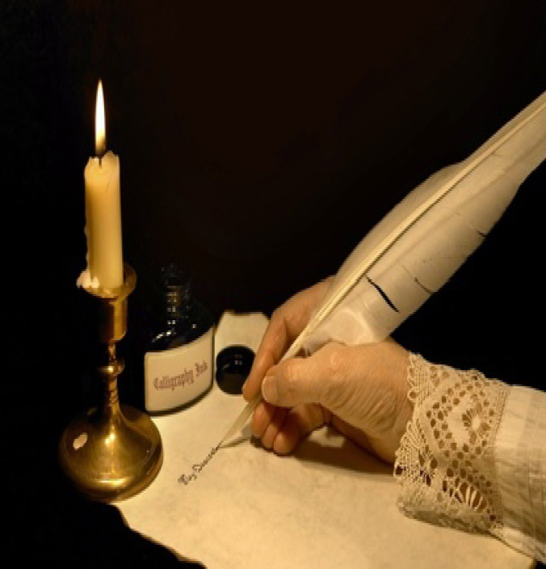
Elizabethan literature can be divided into three genres /belle lettres style:
Drama
Poetry
Prose

Slide 17
Poetry
During this time the writing of poetry was the part of education among the literate people. That is why many books of poetry by different writers appeared during this age. It was a period of literary freedom that provided grounds for experimentation for the poets. During the reign of Elizabeth I the political situation was stable and the Romantic Era was starting to bloom that gave birth to the poetry of romanticism ideals and melodrama. The works would combine tragedy and comedy as in some of Edmund Spenser’s poetry. Poetry during this age featured imagination and intense emotions. The literary works adhered to some form of rhyming meter and structure as experienced in the sonnet which is also a feature of Elizabethan poetry introduced by Sir Thomas Wyatt.

Slide 18
Sir Thomas Wyatt and the Earl of Surrey are often mentioned together, but there are many differences in their work. Both wrote sonnets (a poem of 14 lines with a fixed form and rhyme pattern), which they learned to do from Italians; but it was Wyatt who first brought the sonnet to England. He followed the tradition of the Petrarchan sonnet with octave and sestet. There was later changed into English sonnet style by Shakespeare, who divided the sonnet into three quatrains and a couplet. Surrey's work is also important because he wrote the first Blank verse in English (verse without rhymes, usually in lines of five iambic feet). Surrey's blank verse, which has been mentioned, is fairly good; he keeps it alive by changing the positions of the main beats in the line.

Slide 19
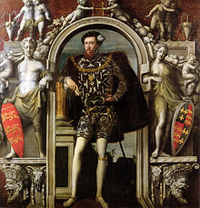
Sir Thomas Wyatt and Henry Howard, Earl of Surrey

Slide 20
Sir Philip Sidney
The Elizabethan age produced many beautiful lyrics. One of the finest lyricists was Sir Philip Sidney, who was a courtier, statesman, soldier and a poet. His books of sonnets Astrophel and Stella was printed in 1591, after his death. Another great poet was Sir Walter Raleigh, who was also a soldier, sailor, explorer, courtier and a writer. Some examples of best Elizabethan lyrics can be found in the plays of Shakespeare. His longer poems Venus and Adonis and The Rape of Lucrece are rather cold and without feelings. But the occasional lyrics found in his dramas are full of feelings and passion. The famous dramatist Marlowe has also written some fine lyrics.

Slide 21
What is a sonnet?
A sonnet is a fourteen line lyrical poem with a fixed form and a rhyme pattern. There are two types of sonnets: Italian and English

Slide 22
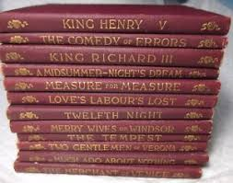
William Shakespeare

Slide 23
Shakespeare's Four Writing Periods
Early Period
Balanced Period
Overflowing Period
Final Period

Slide 26
William Shakespeare as poet
The greatest dramatist Shakespeare was also a great poet of this age who wrote around 154 sonnets and they are very famous in English literature. He developed a new form of sonnet called the English sonnet or the Shakespearean sonnet. The rhyme scheme was abab cdcd efef gg. It is different from Petrarchan sonnet. Many of his sonnets refer to a girl, a rival poet and a friend.

Slide 27
Edmund Spencer

Slide 28
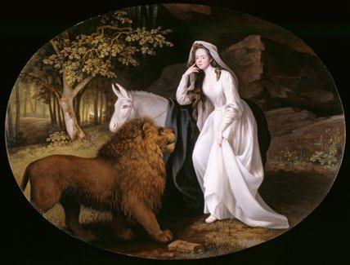
Edmund Spencer was a famous poet who introduced the Elizabethan age properly. In 1579, he wrote The Shepherd’s Calendar and The Faerie Queen . Though it was planned to be written in twelve books, he could complete six of them. It is an allegorical work with three themes: a political theme, a moral theme, and a fairy tale. More than the story, this work is known for its magic feeling, wonderful music in verse, and the beauty of the sound.

Slide 29
"The Shepherd's Calendar", a poem in twelve books, one for each month of the year. Spenser was no doubt making experiments in meter and form, examining his own abilities. The poems are unequal, but those for April and November are very good. They take the form of discussions between shepherds, and are therefore pastorals - concerning the life of shepherds (who look after sheep in the fields) -the best pastorals written in English up to that time. There are various subjects: praise Queen Elizabeth, discussions about religion, the sad death of a girl, and so on. The nation welcomed the book; it was expecting a great literary age, and accepted this work at its beginning.

Slide 30
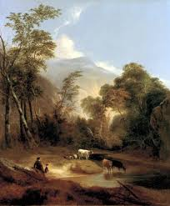
Pastorals portraying or expressive of the life of shepherds or country people especially in an idealized and conventionalized manner

Slide 31
Spenser's masterpiece is the epic poem The Faerie Queene as planned in 12 books, but he wrote little more than the first six. Despite this, it remains one of the longest poems in the English language. It is an allegorical work, and can be read (as Spenser presumably intended) on several levels of allegory, including as praise of Queen Elizabeth I. The Queene is either Queen Elizabeth or Glory as a person. There are 12 knights representing different Oueene virtues. The Knights' adventures are the basis for as allegory (a story which teaches a lesson because the people and places in it stand for other ideas). The greatness of the work is not in its thought or its story. It is in the magic feeling in the air, the wonderful music of the verse, the beauty of the sound.

Slide 32
Elizabethan prose
Many writers of the Elizabethan age translated various books into English.
Sir Thomas North translated Plutarch’ “Lives of the Noble Grecians and Romans”. He was one of the best translators with a good command of English. He also had the ability to weave words into powerful sentences.

Slide 33
John Lily
Some of the forms of novel also appeared during the Elizabethan age, John Lily wrote a kind of novel named Euphuism. He started a fashion, which spread in books and conversation called Euphuism.
It has a thin love story. This style is filled with tricks and alliteration. The sentences are rather long and complicated. This kind of language style was common among ladies of the time. Even Shakespeare was influenced by this artificial style.

Slide 34
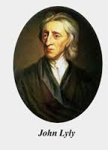
John Lyly

Slide 35
What is Euphuism?
The term ‘euphemism’ is used to refer to using a comparatively milder or less harsh form of a negative description instead of its original, unsympathetic form. This device is used when writing about matters such as violence, death, crimes and some "embarrassing“ things or notions. The purpose of euphemisms is to substitute unpleasant and severe words with more gentle ones in order to mask the harshness.
Example: Gone to heaven - This is a polite way to say that someone is dead.

Slide 36
Francis Bacon, 1st Viscount St Alban

Slide 37
Francis Bacon
Bacon is one of the most famous prose writers of the time. Francis Bacon is also known as the father of the English prose. He wrote books both in English and Latin.
1st Viscount Saint Alban, also called (1603–18) Sir Francis Bacon lord chancellor of England. A lawyer, statesman, philosopher, and master of the English language, he is remembered in literary terms for the sharp worldly wisdom of a few dozen essays.

Slide 38
His "Essays" especially are still popular and studied. They first appeared in 1597 and then with additions in 1612 and 1623. The sentences in the early essays are short, sharp and effective; the style of the later essays is rather more flowing. Some of the best known sayings in English, come from Bacon's books, and especially from the "Essays".
Other books by Bacon include "A History of Henry VII" (1622), which was written in a few months. "The Advancement of Learning" (1605) considers the different ways of advancing knowledge, and the divisions of knowledge, such as poetry and history. "The New Atlantis" (1626) contains social ideas in the form of a story. This story is of a journey to an imaginary island, Bensalem, in the Pacific Ocean. Bacon wrote several other books in English.

Slide 39
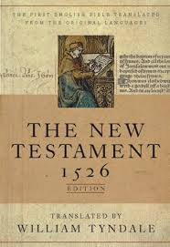
William Tyndale – English scholar
Tyndale was educated at the University of Oxford and became an instructor at the University of Cambridge, where, in 1521, he fell in with a group of humanist scholars meeting at the White Horse.
Tyndale became convinced that the Bible should determine the practices and doctrines of the church and that every believer should be able to read the Bible in his own language.

Slide 40
The Authorized Version of the Bible appeared in 1611. The history of the English Bible is important. In Old English several translations of parts of the Bible were made, but the first complete translation was John Wycliffe's. William Tyndale translated the New Testament from the Greek, and part of the Old Testament from the Hebrew, a language native to Israel. At that time it was necessary to ask permission of the Bishop of London, but the permission to Tyndale was not granted and he had to leave England and go overseas to do his work in Germany. Bible translation in those days was high and dangerous adventure. Tyndale was later burnt to death for his beliefs, but he is remembered for his careful and important work on the translation that was very important for further translation of The Authorized Version of the Bible.

Slide 41
William Tyndale
At the time of his death, several thousand copies of his New Testament had been printed; however, only one intact copy remains today at London’s British Library. The first vernacular English text of any part of the Bible to be so published, Tyndale’s version became the basis for most subsequent English translations, beginning with the King James Version of 1611 - The Authorized Version of the Bible .

Slide 42
The Metaphysical Poets
When the songs and sonnets of the great Elizabethan age passed away slowly, the lyrical power began to lose its force. A group of poets, known as the Metaphysical poets, began to write poems which were less beautiful and less musical, but full of intellectual images. These poets tried to say what they hoped had never been said before. They searched all fields of knowledge, science, as well as, nature, for comparisons and tried to say in a style never used before. This made their poetry difficult to understand.

Slide 43
John Donne

Slide 44
Metaphysical poetry. John Donne is a great metaphysical poet but it is difficult to find a complete poem by him which is faultless (безупречный). Не wrote many good things, but no perfect poem. His songs and sonnets are probably his finest work, but he is best studied in collections of verse by various poets. He wrote a lot of poor verse which these collections omit. In meter Donne often put the main beat on words of little importance.
As a passionate lover he was always analytic, thoughtful, trying to dissect (analyze) and explain his passion almost scientifically.
Donne was a lawyer and a priest, and he wrote religious poetry, though it is not his best. Later he became a Dean – настоятель собора, католический, at St. Paul Cathedral.

Slide 45
John Donne
The metaphysical style was started by John Donne, early in the 17th Century. Donne was a lawyer and a priest, and he also wrote religious poetry. His songs and sonnets are his finest works. He had made good use of direct speech to give a colloquial touch to his poems. He also used dramatic realism in his poetry.
John Donne is a great metaphysical poet but it is difficult to find a complete poem by him which is faultless. Не wrote many good things, but no perfect poem. In meter Donne often put the main beat on words of little importance.
As a passionate lover he was always analytic, thoughtful, trying to analyze and explain his passion almost scientifically.
Donne was a lawyer and a priest, and he wrote religious poetry, though it is not his best. Later he became a Dean – at St. Paul Cathedral.

Slide 46
Famous lines of John Donne
“Death, be not proud, though some have called thee
Mighty and dreadful, for thou art not so; For those, whom thou think'st thou dost overthrow,
Die not, poor Death, nor yet canst thou kill me.”
Нет человека, который был бы как Остров,
сам по себе, каждый человек есть часть Материка, часть Суши;
и если Волной снесет в море береговой Утес,
меньше станет Европа,
и также если смоет край Мыса и разрушит
Замок твой и Друга твоего;
смерть каждого Человека умаляет и меня,
ибо я един со всем Человечеством,
а потому не спрашивай никогда, по ком звонит Колокол;
он звонит и по Тебе.

Slide 47
Elizabethan DRAMA

Slide 48
The greatest dramatists of Elizabethan age are:
Christopher Marlowe
William Shakespeare
Ben Jonson

Slide 49
Ben Jonson

Slide 50
The dramatist Ben Jonson, known as "Rare Ben Jonson", was an English Renaissance dramatist, poet and actor. A contemporary of William Shakespeare, he is best known for his satirical plays, a quarrelsome man, but fearless and honest. He has left plays, poems and prose. One of his best lyrics is "To Celia".
"Timber" or "Discoveries" (1640) by the dramatist Ben Jonson, is the collection of notes and ideas on various subjects. Until Jonson wrote his book, nothing had appeared to make clear the true work of a critic, his aims and limitations. Jonson says that a critic ought to judge a work as a whole, and that the critic herself must have some poetic abilities.

Slide 51
Jonson is the father of English literary criticism. His critical ideas are not limited to this book, but appear elsewhere. He has some interesting things to say. He thought that John Donne, "for not keeping an accent (proper beat) deserved hanging". He was not pleased with Spenserian stanza or with Spencer's language. When he was told that Shakespeare had never "blotted a line" (= crossed a line out), he wished that he had "blotted a thousand". Jonson's ideas were much influenced by the classics, and this explains much of what he says.

Slide 52
Christopher Marlowe was the son of a shoemaker who, with the help of a scholarship, obtained his master's degree at Cambridge in 1587 and became a famous dramatist, was also a fine lyric writer.
The six or seven plays Marlowe managed to write before his early death were highly successful. Some of his plays that are famous are: Tamburlaine 1587, The Jew of Malta (1589), and Doctor Faustus. (1588) He perfected the use of blank verse so that it became famous as Marlowe’s Mighty Lines.
He was an atheist. At a young age, he was involved in killing a man and was killed in a fight. It is also possible that Marlowe was a secret agent for Queen’s Government, and that enemies who killed him were the country’s enemies, the mystery of his short life remains.

Slide 53
Christopher Marlowe

Slide 54
Doctor Faustus, in full The Tragicall History of D. Faustus, tragedy in five acts by Christopher Marlowe, published in 1604.
Marlowe’s play followed by only a few years the first translation into English of the medieval legend on which the play is based. In Doctor Faustus Marlowe retells the story of Faust, the doctor-turned-necromancer, who makes a pact with the devil in order to obtain knowledge and power. Both Doctor Faustus and Mephistopheles, who is the devil’s intermediary in the play, are subtly and powerfully portrayed. Marlowe examines Faustus’s powerful intellectual ambitions, revealing them as futile, self-destructive, and absurd.

Slide 55
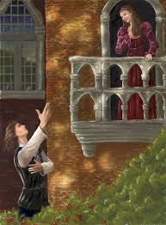
William Shakespeare
http://www.biography.com/people/william-shakespeare-9480323

Slide 56
Shakespeare is renowned as the English playwright and poet whose body of works is considered the greatest in history of English literature. Shakespeare wrote more than thirty plays. These are usually divided into four categories: histories, comedies, tragedies, and romances.
His earliest plays were comedies and histories such as Henry VI and The Comedy of Errors, but in 1596, Shakespeare wrote Romeo and Juliet, his second tragedy, and over the next dozen years he wrote tragedies for which he is now best known: Julius Caesar, Hamlet, Othello, King Lear, Macbeth, and Antony and Cleopatra. His famous comedies are A Midsummer Night’s Dream and As you Like it. In his final years, Shakespeare turned to the romantic with Cymbeline, A Winter’s Tale, and The Tempest.

Slide 57
Famous Lines:
Macbeth:
To-morrow, and to-morrow, and to-morrow,
Creeps in this petty pace from day to day,
To the last syllable of recorded time;
And all our yesterdays have lighted fools
The way to dusty death. Out, out, brief candle!
Life's but a walking shadow, a poor player,
That struts and frets his hour upon the stage,
And then is heard no more. It is a tale
Told by an idiot, full of sound and fury,
Signifying nothing.
(Macbeth Act 5, scene 5, 19–28)

Slide 58
Explanation
Life is meaningless. It is lasts for a brief time and is full of "sound and fury", but in the end, nothing lasts. Life, a "walking shadow", something useless, really doesn't amount to anything. Macbeth is realizing that all his struggles to become king and to keep the throne have come to nothing. He "made a lot of noise" and created quite a story, fought quite a battle, but in the end, nothing is to come of it.

Slide 59
Romeo and Juliet
“What's in a name? That which we call a rose
By any other word would smell as sweet.”
Explanation: Your name does not define you. In her world, your name — or the family that you come from — sets out how people view you. The idea that you should be judged by your qualities or achievements is a modern idea expressed by Juliet.

Slide 60
Questions
Multiple Choice
Short Answer Questions

Slide 61
Which age is regarded as the golden age in English Literature?
(Modern, Elizabethan, Restoration, Old English)
2. Sir Thomas Wyatt brought __________ from Italy.
(Dramatic from, lyrical poetry, sonnet form, elegy)
3. ___________________wrote the first blank verse in English.
(Shakespeare, Thomas Kyd, Marlowe, . The Earl of Surrey )
4. Choose the English sonnet from the following rhyming scheme:
abba abba cde cde
abab cdcd efefe gg
5. A sonnet has ________lines.
(10, 13, 14, 5)

Slide 62
6. ______________has nine lines, with the rhyme scheme : ababbcbcc.
(Spenserian stanza , English Sonnet, Italian sonnet, epic)
7. The purpose of ________________is to substitute unpleasant and severe words with more genteel ones in order to mask the harshness.
(metaphor., euphemisms, similes)
8. _______________ is also known as the father of the English prose.
(Shakespeare, Marlowe, Ben Jonson, Francis Bacon )
9. Who was the famous Metaphysical poet?
(Ben Jonson, Shakespeare, John Donne, Milton)
9. “ Death, be not proud…” is a poem by ___________________
(Ben Jonson, Shakespeare, John Donne, Milton)
Say whether the following sentence sis true or false:
Blank verse is a line that has no rhyme, but is does have a definite rhythm.
The Spanish Tragedy is not an example of Elizabethan drama.

Slide 63
11. Who perfected blank verse: Shakespeare or Marlowe?__________________________
12. In the play Doctor Faustus, Dr. Faustus sells his soul to Lucifer____
To become the most intelligent person in the world.
To have power and riches in the world
To marry Helen of Troy
To meet King Charles of France.
Romeo and Juliet was written by:
(Shakespeare, Marlowe, Ben Jonson, Tomas Kyd)
14. Shakespeare wrote ___________sonnets.
(154, 152, 150, 155)

Slide 64
15. Hamlet, Othello, King Lear, and Macbeth are the examples of _________ by Shakespeare.
(comedies, romances, tragedies, tragi-comedies)
16. Which of the following is a comedy by Shakespeare?
Macbeth
As You Like it
Othello
Macbeth
17. Ben Jonson followed _________________in his plays.
Unity of time
Unity of Place
Unity of Action
Unities of time, place and action

Slide 65
Short Answer Question:
Who wrote the following lines? Explain them.
“Shall I compare thee to a summer’s day? Thou art more lovely and more temperate: Rough winds do shake the darling buds of May, And summer’s lease hath all too short a date: Sometime too hot the eye of heaven shines, And often is his gold complexion dimm’d; And every fair from fair sometime declines, By chance, or nature’s changing course untrimm’d; But thy eternal summer shall not fade…”
___________________________________________________________________
“Death, be not proud, though some have called thee
Mighty and dreadful, for thou art not so ;
For those, whom thou think'st thou dost overthrow,
Die not, poor Death, nor yet canst thou kill me”

Slide 66
“Was this the face that launch'd a thousand ships,
And burnt the topless towers of Ilium?
Sweet Helen, make me immortal with a kiss.
O, thou art fairer than the evening air
Clad in the beauty of a thousand stars.”
________________________________________________________
“To-morrow, and to-morrow, and to-morrow,
Creeps in this petty pace from day to day,
To the last syllable of recorded time;
And all our yesterdays have lighted fools
The way to dusty death. Out, out, brief candle!
Life's but a walking shadow, a poor player,
That struts and frets his hour upon the stage,
And then is heard no more. It is a tale
Told by an idiot, full of sound and fury,
Signifying nothing.”
_______________________________________________________
“What's in a name? That which we call a rose
By any other word would smell as sweet.”

