Slide 1
Modernism and Post-Modernism

Slide 3
Modern vs modernism
Modern: up to date
Modernism (almost) fixed in time
A specific literary style or styles

Slide 4
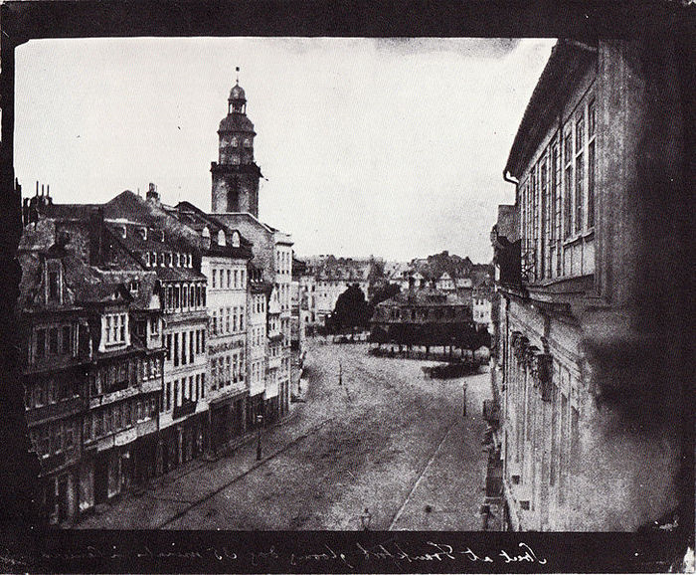
What came before?
New trends in literature are often a reaction to previous styles

Slide 5
Modernist literature
Reacts against the Victorian novel

Slide 6
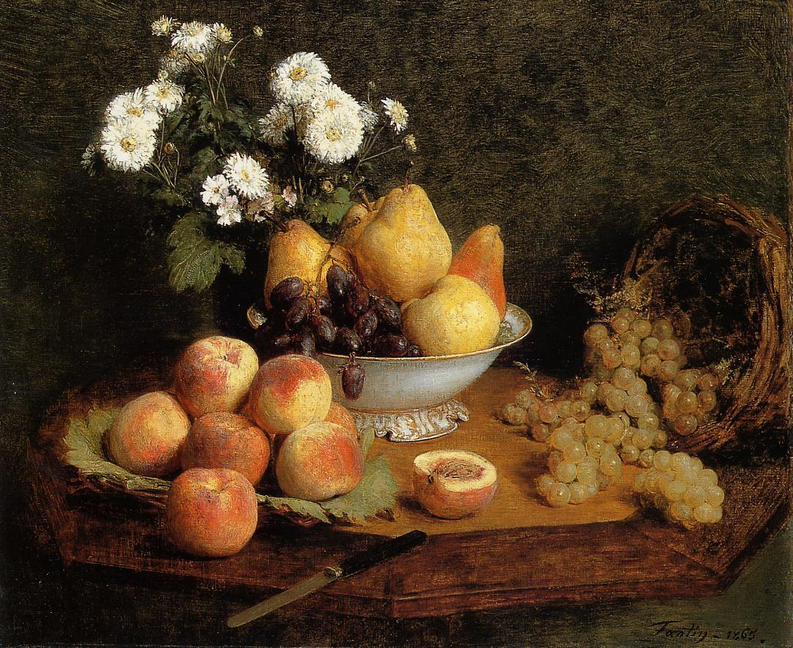
Modernist literature
Reacts against 19th century realism

Slide 7
Modernist literature
Reacts to modernisation of society
Mass-production
Over-consumption
Growing socialism
Increasing bureaucracy
Increasing alienation of the individual

Slide 8
Modernism
Often questions that which has gone before
It also questions the future
It offers a critique of “modern” culture
It puts into question the results of western achievements
Often pessimistic in tone
psychological themes

Slide 9
A Collection of techniques
often experimental
often challenging
often attempts to reproduce the inner workings of the mind
none of which are new!

Slide 10
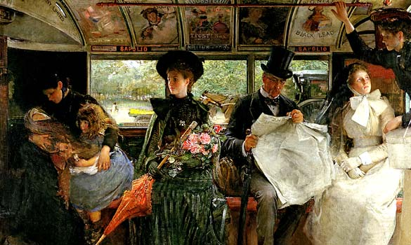
Against objective realistic representation

Slide 11
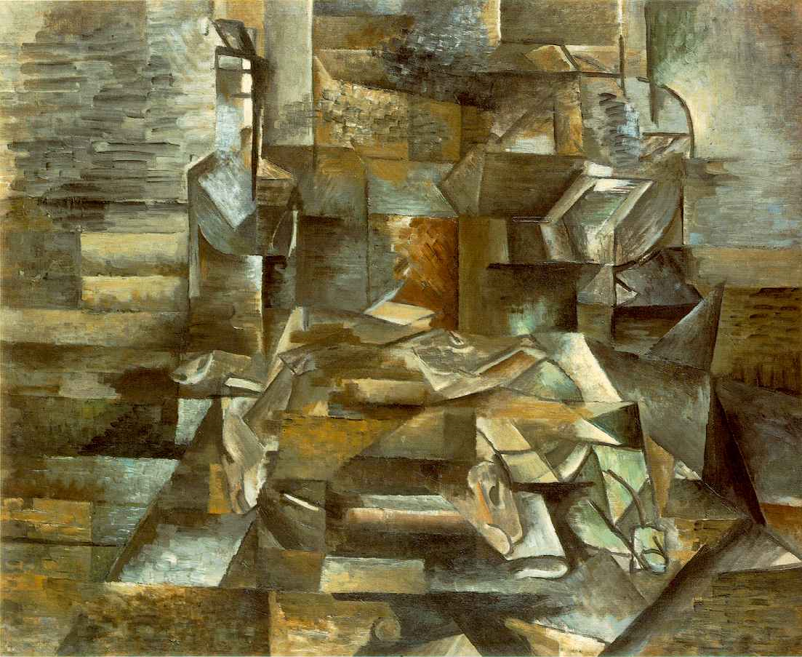
Cubism
rejection of smooth transitions and standard form
Representation of multiple viewpoints simultaneously
In literature can be seen in a rejection of linear narrative

Slide 12
Mondrian:
Total rejection of
representation

Slide 13
Some techniques
Point of view?
Satire
Intertextuality
Symbolic representation
Discontinuity
Stream of consciousness
Pastiche

Slide 14
Themes
Breakdown of social norms
Fear of a meaningless future
Loss of spirituality – loneliness
Rejection of past culture and history
Rejection of tradition
Disillusionment in western values
Artificiality and Commodification
Wow what a cheerful bunch they were

Slide 15
Some Modernist writers
Joseph Conrad Heart of Darkness
James Joyce Ulysses
Franz Kafka The Metamorphosis
Virginia Woolf A Room of Ones Own
T.S. Eliot The Wasteland
Samuel Beckett Waiting for Godot
William Faulkner The Sound and the Fury
Malcolm Lowry Under the Volcano

Slide 16
Postmodernism

Slide 17
Postmodernism
Does not ”follow on ” from modernism
Does come after modernism
Not a literary style, more of a modern philosophy
Applies the same techniques
Has a different outlook
Generally less pessimistic
Black humor return to satire

Slide 18
Post modernism – same techniques?
Point of view – modernism withdrew, post modern writers often re-enter
Satire
Intertextuality
Symbolic representation
Discontinuity – increased non-linearity
Stream of consciousness – less common
Pastiche

Slide 19
Point of view
Writers change narrator perspective
E.g. Paul Auster Invisible 2009
Moves from 1st person to 3rd person to 2nd person
V.S.Naipaul The Mystic Masseur 1957
Moves from participant 1st person to non-participant omniscient narrator
Arundhati Roy The God of Small Things 1996
Moves from child to adult perspective using a non-linear narrative

Slide 20
Non-sequential narratives
(non-linear, non-chronological)
Writer controls the plot around the significance of events rather than logical order
Parallel timelines
Flashbacks
Episodic narratives
Reversed narrative – begins at climax

Slide 21
Examples non-linear narrative
Kurt Vonnegut – Slaughterhouse-five 1969
Irvine Welsh - Trainspotting 1993
Arundhati Roy – The God of Small Things 1996
Margaret Atwood – Oryx and Crake 2003

Slide 22
Developments in literature – 20th century and 21st century
Novels, novels, novels
Poetry loses ground
Increasing genre diversity
E.g. Science fiction and fantasy
Pulp and trivial literature
S.F., detective novels, romances*
*Blurred boundaries between high and low literature

Slide 23
Increased social scrutiny
Different critical “perspectives” increase
Feminism
Postcolonial literature
Marxism and class
Eco-criticism
New-historicism
“Queer theory” – gay and lesbian criticism

Slide 24
Increased social scrutiny
Not just ways of writing literature but also ways of analysing them
Literary criticism
Socio-cultural contexts
Prevalent from 1960s onwards

Slide 25
Post-colonial voices
Search for identity after colonialism
Globalization spreads western writing traditions – world literature becomes increasingly homogenized
Paradox?
Post-colonial writers often break new ground

Slide 26
Post-colonial voices
Example: magical realism
Combined reality and fantasy
Fantasy as an everyday event
Salman Rushdie
Gabriel Garcia Marquez

Slide 27
Marginalized voices
Women, homosexuals, coloured
The Other
Virginia Woolf (modernist)
Simone de Beauvoir (theorist)
Toni Morrison Beloved
Alice Walker The Color Purple
Jeanette Winterson Oranges are not the Only Fruit

