Slide 1
THE BOOK

Slide 2
THE BENEFITS OF READING BOOKS
„A book is like a garden carried in the pocket." (Chinese Proverb)
Reading exercises your brain
provides knowledge and information and is a good topic of conversation
improves concentration and enriches the vocabulary and language
forms better writing skills
improves memory
Improves focus and concentration
stimulates further reflection and analytical skills
develops creativity
reduces stress and puts you in a better mood and is great and free entertainment
opens a window to different worlds

Slide 3
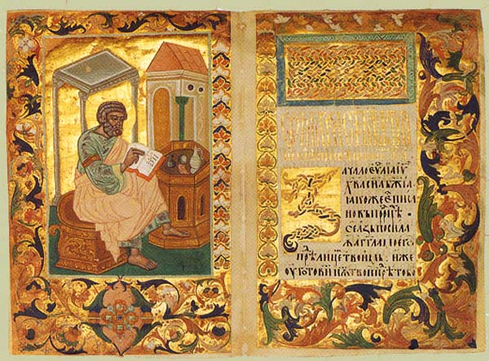
The oldest dated monument of East Slavic literature is the Ostromir Gospel, the oldest East Slavic book dated from 1056 or 1057. But the vast majority of monuments from the eleventh and twelfth centuries are undated or extant only in later transcriptions.

Slide 4
Clearly these are not the oldest monuments, for the literary language and traditions (Church Slavonic) unquestionably came to Kiev together with Christianity towards the end of the tenth century. However, it is certain that there were Christians in Kiev several decades earlier; one need only cite as examples either the Christian Varangians (people that lived in Kievan Rus, of scandinavian origin - vikings) killed in the time of Volodymyr or Ol’ha, the wife of Prince Ihor. In the performance of divine service, if it was not Greek, Bulgarian or Moravian books could have been used. Also extra-literary are the translations of the treaties between Kievan Rus’ and the Greeks (preserved in the chronicles) dating from 911 and 944. More interesting is the oral tradition (or folk poetry) which is believed to have already been in existence at that time.

Slide 5
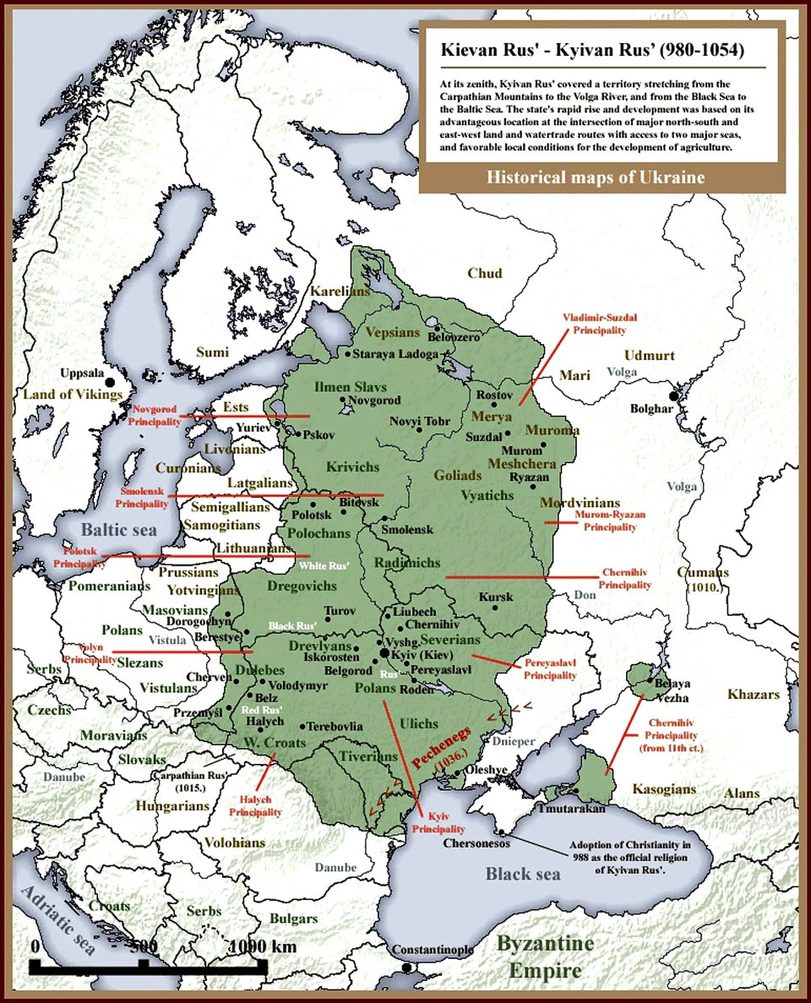

Slide 6
Ukraine
The Primary Chronicle (Old Church Slavonic: Повѣсть времяньныхъ лѣтъ) is a history of Kievan Rus’ from about 850 to 1110th C.
The Tale of Igor's Campaign (Old East slavic 12th C. Slavic pagan mythology);

Slide 7
Periods of Old English Literature
English language is divided into main periods:
Old English (449-1100)
Old period or Anglo-Saxon
The fifth to sixth century Anglo-Saxon settlement of Britain Danish invasion of England, ending successfully at the Battle of Assandun in 1016.
The 1066 Norman conquest of England under William the Conqueror.
500)
Middle English (1100-1200)
Modern English (1500-)
Contemporary English

Slide 8
The Dark Ages
Historical events: 7thC. – 10thC.- The Dark Ages
Celts (GAULS), they were Romanized later by Romans,
Germanic tribes: Angles, Saxons, Jutes, 8th C.
Danish invasions, Normans
Kings: Alfred (9thC.)
Writers: Caedmon, Cynewulf, Alfred, Aelfric

Slide 10
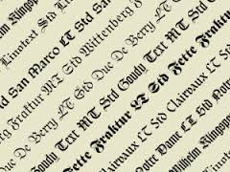
OLD ENGLISH LITERATURE
OLD ENGLISH POETRY
OLD ENGLISH PROSE
OLD ENGLISH DRAMA

Slide 11
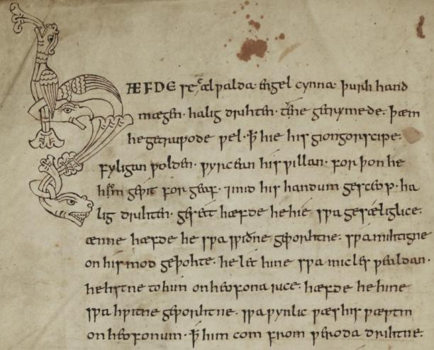
OLD ENGLISH LITERATURE
OLD ENGLISH IS THE LANGUAGE AND LITERATURE OF THE ANGLO SAXON
ANGLO SAXON RULED ENGLAND FROM 450 AD TO 1066
OLD ENGLISH IS DIRECTLY RELATED TO MODERN ENGLISH (MANY OF OUR WORDS COME FROM OLD ENGLISH)
OLD ENGLISH WAS FIRST ORAL (WITH RUNIC INSCRIPTIONS) THEN USED ALPHABET (WITH SOME SPECIAL CHARACTERS) WRITING ON MANUSCRIPTS)

Slide 12
Old English prose works include legal writings, medical tracts, religious texts, and translations from Latin and other languages. Particularly notable is the Anglo-Saxon Chronical, a historical record begun about the time of King Alfred’s reign (871–899) and continuing for more than three centuries.
Old English poetry has survived almost entirely in four manuscripts: the Exeter Book, the Junius Manuscript, the Vercelli Book, and the Beowulf manuscript.
Old English Drama was introduced to Britain from Europe by the Romans. These were folk tales re-telling old stories, and the actors travelled from town to town performing “pro “bitter comedies”blem plays”,for the people.... In addition, they wrote his so-called "problem plays“ and "bitter comedies“.
Old English was not static, and its usage covered a period till the late 11th century, some time after the Norman invasion, they brought with them the language, changed the language and culture.
.

Slide 15
Old English makes use of unfamiliar letters, most of which derive from the runic alphabet, an alphabet used by the Germanic peoples.

Slide 17
Anglo-Saxon literature (or Old English literature) encompasses literature written in Anglo-Saxon during the 600-year Anglo-Saxon period of Britain, from the mid-5th century to the Norman Conquest of 1066. These works include genres such as epic poetry, hagiography, sermons, Bible translations, legal works, chronicles, riddles, and others. In all there are about 400 surviving manuscripts from the period, a significant corpus of both popular interest and specialist research.

Slide 18
WHY IS OLD ENGLISH SO IMPORTANT ?
IT SHOWS US WHERE ENGLISH COMES FROM AND HOW IT RELATES TO OTHER LANGUAGE
IT TELLS US ABOUT THE HISTORY, SOCIETY, AND GEOGRAPHY OF ENGLAND

Slide 19
Old English poetry falls broadly into two styles or fields of reference, the heroic Germanic and the Christian. With a few exceptions, almost all Old English poets are anonymous.
Even though all extant Old English poetry is written and literate, it is assumed that Old English poetry was an oral craft that was preformed by a scop and accompanied by a harp.

Slide 20
Elegiac poetry
Related to the heroic tales are a number of short poems from the Exeter Book which have come to be described as "elegies" or "wisdom poetry".They are lyrical and Boethian in their description of the up and down fortunes of life. Gloomy in mood is The Ruin, which tells of the decay of a once glorious city of Roman Britain (cities in Britain fell into decline after the Romans departed in the early 5th century, as the early English continued to live their rural life), and The Wanderer, in which an older man talks about an attack that happened in his youth, where his close friends and kin were all killed; memories of the slaughter have remained with him all his life.

Slide 21
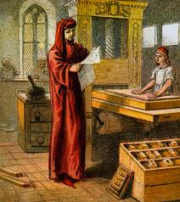
CLASSICAL AND LATIN POETRY
Several Old English poems are adaptations of late classical philosophical texts. The longest is a 10th-century translation of Boethius' Consolation of Philosophy contained in the Cotton manuscript Otho A.vi. Another is The Phoenix in the Exeter Book, an allegorisation of the De ave phoenice by Lactantius.
Other short poems derive from the Latin bestiary tradition. Some examples include The Panther, The Whale and The Partridge. Bestiary is a collection of stories in poems with some alegorial aim (fables).

Slide 22
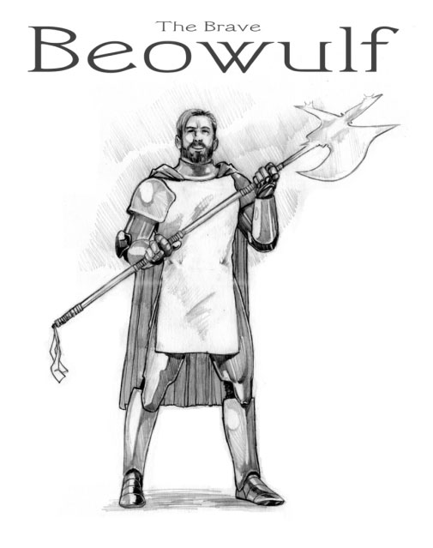
Is a long heroic poem considered the supreme achievement of Anglo-Saxon poetry because of its length (3,182 lines) and sustained high quality.
Characteristics of OE poetry - Alliteration: Alliteration is the repetition of stressed sounds, particularly consonants from the beginning of words or syllables. Poetically, alliteration can has a similar function as rhyme. An example of alliteration is the tongue-twister "She sells seashells by the sea shore."

Slide 23
"Beowulf" is the oldest surviving epic poem in the English language and the earliest piece of vernacular European literature. Perhaps the most common question readers have is what language "Beowulf" was written in originally. The first manuscript was written in the language of the Saxons, “Old English," also known as "Anglo-Saxon." Since then, the epic poem has been estimated to have been translated into 65 languages.

Slide 24
It tells the story of the legendary Geatish hero Beowulf who is the major character.
The story is set in Scandinavia, in Sweden and Denmark, and the tale likewise probably is of Scandinavian origin.
The story is biographical and sets the tone for much of the rest of Old English poetry.
It has achieved national epic status, on the same level as the Iliad, an ancient Greek epic poem by Homer, and is of interest to historians, anthropologists, literary critics, and students the world over.It glorifies the pagan virtues and some influence of Chrisitianity

Slide 25
Caedmon (the 7th c/ )was one of the religious writers of the time. His works were based mainly on the Old Testament. Some historians have attributed to Caedmon writing a 3,000-verse poem about the creation of the world (Genesis), which basically follows the Bible text with some departures.
Caedmon may have also written two other works, Exodus and Daniel, though some feel that all three works have anonymous authorship. Exodus deals with the Israelite escape from Egypt and the miraculous crossing of the Red Sea. Daniel includes the fall of Jerusalem, the two dreams of Nebuchadnezzar and Daniel's interpretation of them, and the miraculous survival of Daniel's three friends in the fiery furnace. A short hymn in praise of the creation, "Hymn of Creation", is also attributed to Caedmon.

Slide 26
A later poet, Cynewulf, and his followers, drew on the New Testament, as well as historical events connected with Christianity. His works include The Fates of the Apostles, a short martyrology, The Ascension (or Christ II), a homily (lecture on moral conduct) and biblical narrative, and Juliana, the story of a saint. The most famous is Elene (Helene), which describes Constantine's victory under the sign of the cross, his conversion, and his mother's legendary miraculous discovery of the original cross in Jerusalem. At this time, the "Holy Cross" cult was spreading across Europe and the cross was becoming sacred. Over the centuries, it would be used as a symbol giving blessing to the expression of man's basest instincts.
Cynewulf's work is clear and technically elegant. His theme is the continuing evangelical mission of the church from the time of Christ to that of Constantine. Cynewulf's followers later produced literature mixing Oriental, pagan, and Christian thought with images from nature and the animal world. For example, "The Panther" symbolized Christ, 'The Whale" the Devil

Slide 27
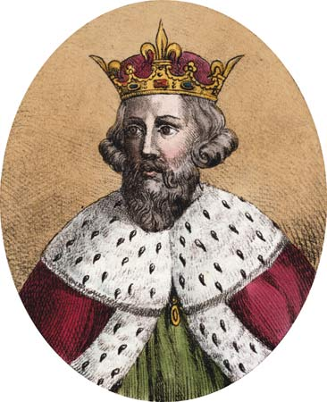
King Alfred
Alfred the Great is famous for his victories against the Vikings, and is the only English monarch known as 'the Great'. To improve literacy, Alfred arranged, and took part in, the translation from Latin into Anglo-Saxon of a handful of books he thought it 'most needful for men to know. Like other West Saxon kings, Alfred as an administrator advocated justice and order and established a code of laws.

Slide 28
Old English Prose
Prose developed later than poetry – in the ninth century, sometimes it also partly contained the characteristics of poetry. It was influenced by Latin, the language of the church and the educated. It consisted of factual, historical, and religious writings. King Alfred the Great (reigned 871-900), one of the most significant rulers of the first millenium, after making peace with the Vikings, made his kingdom into a cultural centre. He translated many works from Latin, especially in the areas of religion, history, philosophy. This was the foundation of the written national language. The first translated was included The Pastor’s Book containing ideals for a pastor, with which Alfred as a secular ruler identified. He also translated Baede’s Church History and other historical accounts. In addition, Alfred compiled medical information, chronicles, and information for law books. His works lacked originality, and were more instructive and educational than artistic and beautiful.

Slide 29
Later Annals and Religious Writings
The first half of the tenth century saw Alfred’s successors expand politically and militarily, but not culturally due to exhaustion from frequent battles with the Vikings. Only the annals continued and some poetry about victories over the Vikings. The Anglo-Saxon Chronicle is the best-known work of historical records spanning even beyond the Norman conquest. It contains both prose and poetry.

Slide 30
Aelfric And Wulfstan
Aelfric abbot of Eynsham, wrote three cycles of forty homilies each (two volumes of Catholic Homilies and Lives of the Saints), as well as other homilies, pastoral letter, and several translations. His writings were clear to understand and beautiful in style. His alliterative prose, which loosely imitated the rhythms of Old English poetry, influenced writers long after the Norman conquest.

Slide 31
Wulfstan, the archbishop of York, wrote civil and church-related legal codes as well as homilies. He denounced the morals of his time and exhorted people to repentance. The belief was that the Viking occupation and the resulting oppession and suffering were the result of sin, and that the end of the world ha at hand.

Slide 32
Old English Drama.
Drama is the specific mode of fiction represented in performance.
The term of drama comes from a Greek word meaning "action" (Classical Greek: δρᾶμα, drama), which is derived from the verb meaning "to do" or "to act" (Classical Greek: δράω, draō).
The origin of drama goes back to brief scenes that monks acted out in churches to iustrate Bible stories.These later developed into full-lenght plays.
Sources of drama were primarily Chatolic traditions and ceremonies that were gradually becoming more wordly.
The Chatolic church throughout Europe controlled almost the entire ideological sphere, including literary art.
Drama was developing in churches where the whole society from the king to the lowest citizen gathered.
There has two strong undercurrents influenced early drama : Folk plays based on ancient nature culls and pagan traditional ; and classic Greek an Latin drama which were preserved, at least in rudimentary form, throughtout the Dark Ages.
Chatolic services were often in the form of drama with colourful robes,recitation,singing,and acting.

Slide 33
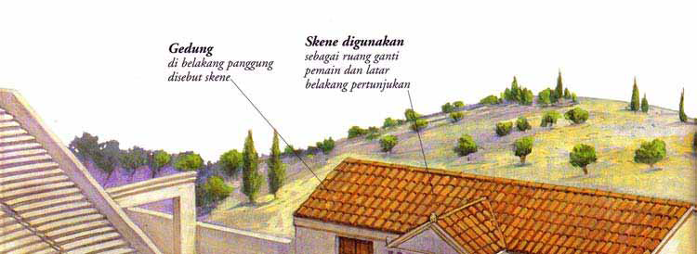
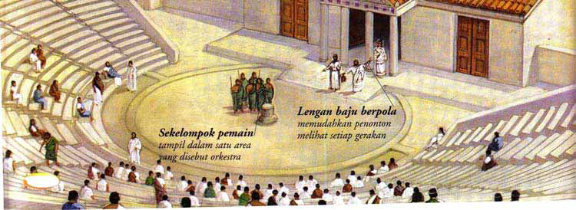
+-2300 years ago stage of old greek theatre

Slide 34
Old English literature did not disappear in the Norman Conquest. Many sermons and works continued to be read and used in part or whole up through the 14th century, and were further catalogued and organised.
In the 17th century begun a tradition of Old English literature dictionaries and references. The first was William Somner's Dictionarium Saxonico-Latino-Anglicum (1659). Lexicographer Joseph Bosworth began a dictionary in the 19th century which was completed by Thomas Northcote Toller in 1898 called An Anglo-Saxon Dictionary, which was updated by Alistair Campbell in 1972. Old English was one of the first vernacular languages to be written down, nineteenth century scholars searching for the roots of European "national culture" (see Romantic Nationalism) took special interest in studying Anglo-Saxon literature, and Old English became a regular part of university curriculum. Since WWII there has been increasing interest in the manuscripts themselves—Neil Ker, a paleographer, published the groundbreaking Catalogue of Manuscripts Containing Anglo-Saxon in 1957, and by 1980 nearly all Anglo-Saxon manuscript texts were in print.
Old English literature has had an influence on modern literature.
Some of the most well known translations include William Morris' translation of Beowulf and Ezra Pound's translation of The Seafarer.
The influence of the poetry can be seen in modern poets T. S. Eliot, Ezra Pound and W. H. Auden.
Much of the subject matter and terminology of the heroic poetry can be seen in The Hobbit, The Lord of the Rings and many others.

