Slide 1
Restoration Drama, Prose & Poetry (XVII century)

Slide 2
Political Context
England and Scotland were united under The Stuart rule after 1603, but remained legally independent with separate political, legal and ecclesiastical systems. Despite domestic strife, the British population grew and its economy prospered. Trade and colonization were extended around the world, while business and commerce grew increasingly sophisticated. The 17th Century was an age of enormous intellectual advance, producing some of Britain's (and the world's) greatest writers (Milton, Dryden), philosophers (Thomas Hobbes, John Locke) and scientists (Isaac Newton, Robert Boyle, Robert Hooke).

Slide 3
Political Context
The Civil War between Charles I and Parliament (Oliver Cromwell) (1642-1646), (1648- 1654)
From 1649-1660 England was a semi-democratic republic. Until 1653 it was under the rule of the House of Commons.
From 1653 until 1658, Oliver Cromwell was lord Protector of the Realm in place of a King and rather like a modern President.
Then Charles II was brought back from exile, the monarchy restored.
The Puritan Movement, in 1620 "Mayflower" started to America.

Slide 4
Philosophical Context
The start of the Restoration period roughly coincides with the beginning of what is known as the Enlightenment, which lasted until the end of the 18th century. The Enlightenment was defined by an emphasis on reason and logic; the thinkers of the period, moreover, helped develop the modern science.
Although the influence of the Enlightenment on the Restoration period is tremendous, it's important to note the humility towards human reason that is common to much Restoration literature. Many Restoration writers viewed the changes to their government, and the violence that these changes brought with them, as the direct result of those who dogmatically held to their ideology.

Slide 5
The Theatre
One of the most significant aspects of Restoration literature is the return of the theatre. As a result of the influence of religious and political leaders who believed the theatre to be sinful, it had been closed for 18 years. Charles II king of England, Scotland and Ireland. Charles, one of the most popular and beloved kings of England, was a big fan of drama and quickly allowed and encouraged the theatre's presence. He had spent much of his exile in France, where theatre had continued to flourish, so it was quite natural that, on his return, French influences would have an impact on English theatre. Thus, in 1642 the theatres were closed (as sinful) by the authority of the parliament which was dominated by Puritans at that time, so no good plays were written from 1642 till the Restoration period (coming back of monarchy in England with the accession of Charles II to the throne) in 1660.

Slide 6
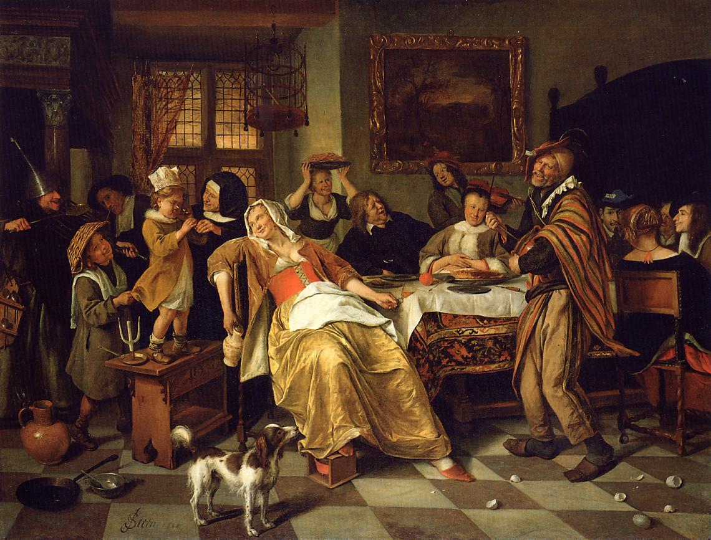
The Theatre

Slide 7
THE THEATRE
The three Unities of action, time and place were originally defined and used in classical Greek theatre and introduced in British Theatre:
the plot had to have a logical consistency
the action had to be completed
the events had to occur in a single location
In addition:
violent events could only happen offstage
the vocabulary was limited, with frequently repeated poetic phrases
there was no vulgarity.

Slide 8
THE THEATRE
The main genres were Heroic plays and the Comedy of Manners. These plays were quite different from Elizabethan plays in some ways. Heroic plays showed the heroic virtues in noble men, and the women were described as wonderfully beautiful. The tragic drama of this period was made up of heroic plays which were mainly written in heroic couplet. The main character in these plays was torn between the patriotic duty to their country and their duty as a lover.
In these dramas we find brave heroes, beautiful women, a great deal of shouting and nonsense things. They showed the life and manners of the upper-class society of the day. These plays laughed at the fashionable society, their witty and fine conversation, and their immoral behaviors. This kind of plays was introduced by Sir George Etherege (1636 -1692). It was mainly addressed to the rich, courtly and fashionable circle of London.

Slide 9
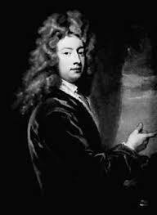
PLAYWRIGHTS
George Etheridge
Etheridge was the first great writer of the Restoration period, writing social comedies of manners that show the influence of Jean-Baptiste Poquelin, known by his stage name Molière.
He was a friend of the notorious Earl of Rochester, whose debauched lifestyle was a model for the Restoration rake. Etheridge was the playwright who set the tone for the great Restoration comedies that followed.
More on Comedy of Manners: The comedy of manners is:
a style of comedy that reflects the life, ideals and manners of upper class society in a way that is essentially true to its traditions and philosophy
The players must maintain the mask of social artifice whilst revealing to the audience what lies behind such manners
In other words it makes the real artificial and the artificial real.

Slide 10
PLAYWRIGHTS
William Wycherley
William Wycherley, (born 1641—died Jan. 1, 1716, London), English dramatist who attempted to reconcile in his plays a personal conflict between deep-seated puritanism and an ardent physical nature. He perhaps succeeded best in The Country Wife (1675), in which satiric comment on excessive jealousy and complacency was blended with a richly comic presentation, the characters unconsciously revealing themselves in laughter-provoking colloquies. It was as satirist that his own age most admired him: William Congreve regarded Wycherley as one appointed “to lash this crying age.”

Slide 11
Restoration Comedy
The most popular form of drama was the Comedy of Manners which portrayed the sophisticated life of the dominant class of society—its gaiety, foppery, insolence and intrigue. Thus the basis of the Restoration drama was very narrow. The general tone of this drama was most aptly described by Shelley:
Comedy loses its ideal universality: wit succeeds humour; we laugh from self-complacency and triumph; instead of pleasure, malignity, sarcasm and contempt, succeed to sympathetic merriment; we hardly laugh, but we smile. Obscenity, which is ever blasphemy against the divine beauty of life, becomes, from the very veil which it assumes, more active if less disgusting; it is a monster for which the corruption of society for ever brings forth new food, which it devours in secret.

Slide 12
John Dryden 1631 –1700)
English poet, literary critic, translator, playwright who was made England’s first Poet Laureate in 1668.

Slide 13
John Dryden 1631 –1700)
Few writers have had so much critical work devoted to them as has John Dryden. His poetry and essays were early studied, their sources noted and discussed, the rhyme and the meter of the one and the literary style of the other written on exhaustively. His heroic plays and tragedies have been only slightly less thoroughly treated. Articles which confine themselves merely to Dryden's use and temporary relinquishment of rhyme in his heroic plays would make a good-sized bibliography.
But very little critical study has been given to Dryden's comedies; in fact, there is no one book which devotes itself solely to them. They are touched on in biographies of Dryden, in histories of Restoration drama or of Restoration literature as a whole, and in a few works on Dryden's criticism; but the authors who discuss them do so only as the least important and least interesting portion of a larger task.

Slide 14
John Dryden 1631 –1700)
Speaking about John Dryden, we should point out that he was the chief protagonist and writer of heroic tragedy, in these plays the men are splendidly brave, and the women wonderfully beautiful. Under John Dryden’s leadership the heroic tragedy dominated the stage from 1660 to 1678. His first experiment in this type of drama was his play Tyrannic love, and in The Conquest of Granada. Nevertheless his grand manner of writing tragedy was criticised by many critics and playwrights, of which Dryden was the main target. Dryden is the one writer of the age who is brilliant in all forms of writing.

Slide 15
John Dryden 1631 –1700)
Dryden’s one of well known play is All for Love(or the World Well Lost) (1678). ) is in blank verse. It is based on Shakespeare's "Antony and Cleopatra". We may well be surprised that he tried to improve on Shakespeare, but we have to remember that in his day "Antony and Cleopatra" was not valued very highly. He said that "All for Love" was the only play that he wrote to please himself. Some critics consider it his best, but others prefer "Don Sebastian" (1691). This was based on the possibility that Sebastian, King of Portugal, had not, after all, been killed.

Slide 16
John Dryden 1631 –1700)
He shifts his ground from the typical heroic tragedy in this play, drops rhyme and questions the validity of the unities of time, place and action in the conditions of the English stage. He also gives up the literary rules observed by French dramatists and follows the laws of drama formulated by the great dramatists of England. Another important way, in which Dryden turns himself away from the rules of the heroic tragedy, is that he does not give a happy ending to this play.
Few or none of Dryden's plays are acted now. They are strangely unequal; there is usually some good, and some bad, writing in each. The poetry of the rhymed plays is on the whole better, and the dramatic force of the unrhymed plays is stronger.

Slide 17
John Dryden 1631 –1700)
In conclusion must be mentioned John Dryden's critical works that include his Essay on Dramatic Poesie (1668) [pouisi:] (the art of writing poetry). This compared English and French drama, and praised Shakespeare. Dryden's prose is important. More than anyone else at this time he led the way to a clear, reasonable and balanced way of writing English. In addition to this he was a better critic than most poets. So John Dryden is the first great name in English Literature of this period, as John Milton was the last great name of the old.

Slide 18
Restoration Prose
As in the fields of poetry and drama, John Dryden was the chief leader and practitioner of the new prose. In his greatest critical work Essay of Dramatic Poesy, Dryden presented a model of the new prose, which was completely different from the prose of Bacon, Milton and Browne. He wrote in a plain, simple and exact style, free from all exaggerations. His Fables and the Preface to them are fine examples of the prose style which Dryden was introducing. This style is, in fact, the most admirably suited to strictly prosaic purposes—correct but not tame, easy but not slipshod, forcible but not unnatural, eloquent but not declamatory, graceful but not lacking in vigour. Of course, it does not have charm and an atmosphere which we associate with imaginative writing, but Dryden never professed to provide that also. On the whole, for general purposes, for which prose medium is required, the style of Dryden is the most suitable.

Slide 19
John Bunyan
John Bunyan (1628-1688). Next to Dryden, Bunyan was the greatest prose-writer of the period. Like Milton, he was imbued with the spirit of Puritanism, and in fact, if Milton is the greatest poet of Puritanism, Bunyan is its greatest story-teller. To him also goes the credit of being the precursor of the English novel. His greatest work is The Pilgrim’s Progress. Just as Milton wrote his “Paradise Lost” to justify the ways to God to men, Bunyan’s aim in The Pilgrim’s Progress was” “to lead men and women into God’s way, the way of salvation, through a simple parable with homely characters and exciting events”. Like Milton, Bunyan was endowed with a highly developed imaginative faculty and artistic instinct. Both were deeply religious, and both, though they distrusted fiction, were the masters of fiction. Paradise Lost and The Pilgrim’s Progress have still survived among thousands of equally fervent religious works of the seventeenth century because both of them are masterpieces of literary art, which instruct as well please even those who have no faith in those instructions.

Slide 20
John Bunyan
In The Pilgrim’s Progress, Bunyan has described the pilgrimage of the Christian to the Heavenly City, the trials, tribulations and temptations which he meets in the way in the form of events and characters, who abstract and help him, and his ultimately reaching the goal. It is written in the form of allegory. The style is terse, simple and vivid, and it appeals to the cultured as well as to the unlettered. As Dr. Johnson remarked: “This is the great merit of the book, that the most cultivated man cannot find anything to praise more highly, and the child knows nothing more amusing.” The Pilgrim’s Progress has all the basic requirements of the traditional type of English novel. It has a good story; the characters are interesting and possess individuality and freshness; the conversation is arresting; the descriptions are vivid; the narrative continuously moves towards a definite end, above all, it has a literary style through which the writer’s personality clearly emanates. The Pilgrim’s Progress is a work of superb literary genius, and it is unsurpassed as an example of plain English.

Slide 21
John Bunyan
The prose of Bunyan shows clearly the influence of the English translation of the Bible (The Authorized Version). He was neither a scholar, nor did he belong to any literary school; all that he knew and learned was derived straight from the English Bible. He was an unlettered country tinker believing in righteousness and in disgust with the corruption and degradation that prevailed all around him. What he wrote came straight from his heart, and he wrote in the language which came natural to him. Thus his works born of moral earnestness and extreme sincerity have acquired true literary significance and wide and enduring popularity. It is quite true to call him the pioneer of the modern novel, because he had the qualities of the great story-teller, deep insight into character, humour, pathos, and the visualising imagination of a dramatic artist.

Slide 22
Restoration Poetry
The Restoration poetry was mostly satirical, realistic and written in the heroic couplet, of which Dryden was the supreme master. The poetry of that time possess all the characteristics of the Restoration period and is therefore thoroughly representative of that age. It does not have the poetic glow, the spiritual fervour, the moral aspects and philosophical ideas, they were sadly lacking in the Restoration period. But it has the formalism, the intellectual precision, the argumentative skill and realism which were the main characteristics of that age.

Slide 23
Dr. Samuel Jonson and James Boswell
Dr. Samuel Jonson was always poor and therefore had to do all kinds of literary work, even if he did not like it. His famous "Dictionary" appeared in 1755 and went into 5 editions in his own life. He was a kind of literary ruler, giving judgements on books and authors like a god. Late in his life he wrote his "Lives of the Poets" (1779-81) with decision and clear expression.
His own writings are less important than what he said, and a record of his conversation has fortunately been preserved for us in the "Life of Johnson" (1791) by his friend James Boswell. This is the greatest biography in English. Johnson's "Raselas Prince of Abyssinia" (1759) is a kind of a novel; at least it has a story. Johnson wrote this book in one week to pay for the mother's funeral.

Slide 24
Samuel Johnson (1709-1784)
Samuel Johnson – poet, biographer, lexicographer and essayist – has been described as ‘arguably the most distinguished man of letters in English history’ (the Oxford Dictionary of National Biography).
Samuel Johnson was born in 1709 in Lichfield, Staffordshire. The son of a bookseller, he rose to become one of the greatest literary figures of the eighteenth century, most famously compiling A Dictionary of the English Language.
Today, according to The Oxford Dictionary of Quotations, Johnson is the second most-quoted Englishman. He most famously said ‘...when a man is tired of London, he is tired of life’.
Other works by Johnson in the 1740s and 1750s include the long poem The Vanity of Human Wishes (1749), the play Irene (performed in 1749, to little success) and the essay series titled The Rambler, in which he discusses the critical literary issues of his day.

Slide 25
Samuel Johnson’s Quatations
Almost every man wastes part of his life attempting to display qualities which he does not possess.
Courage is the greatest of all virtues, because if you haven't courage, you may not have an opportunity to use any of the others.
Knowledge is of two kinds. We know the subject ourselves, or we know where we can find information upon it.

Slide 26
Dictionary of the English Language by Samuel Johnson

Slide 27
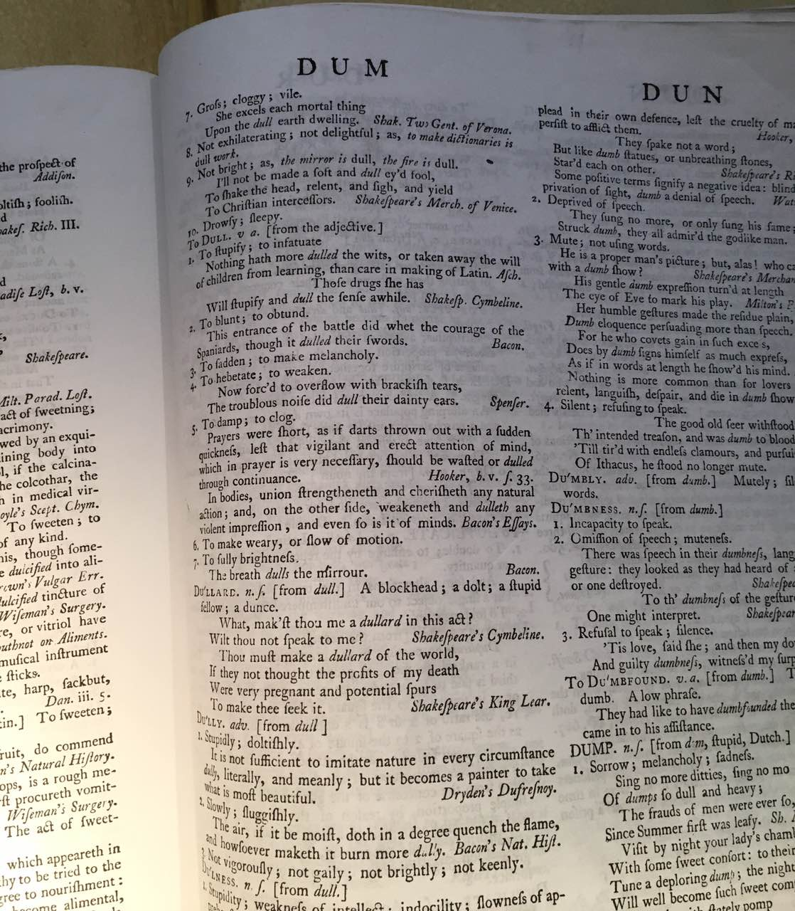

Slide 28
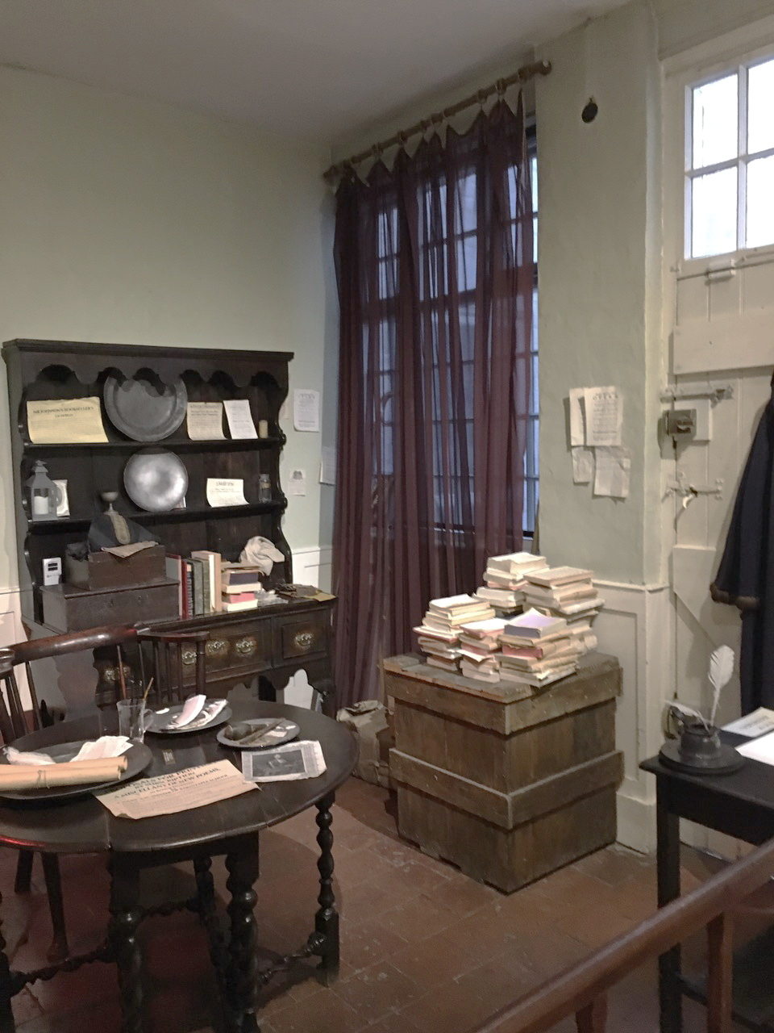

Slide 29
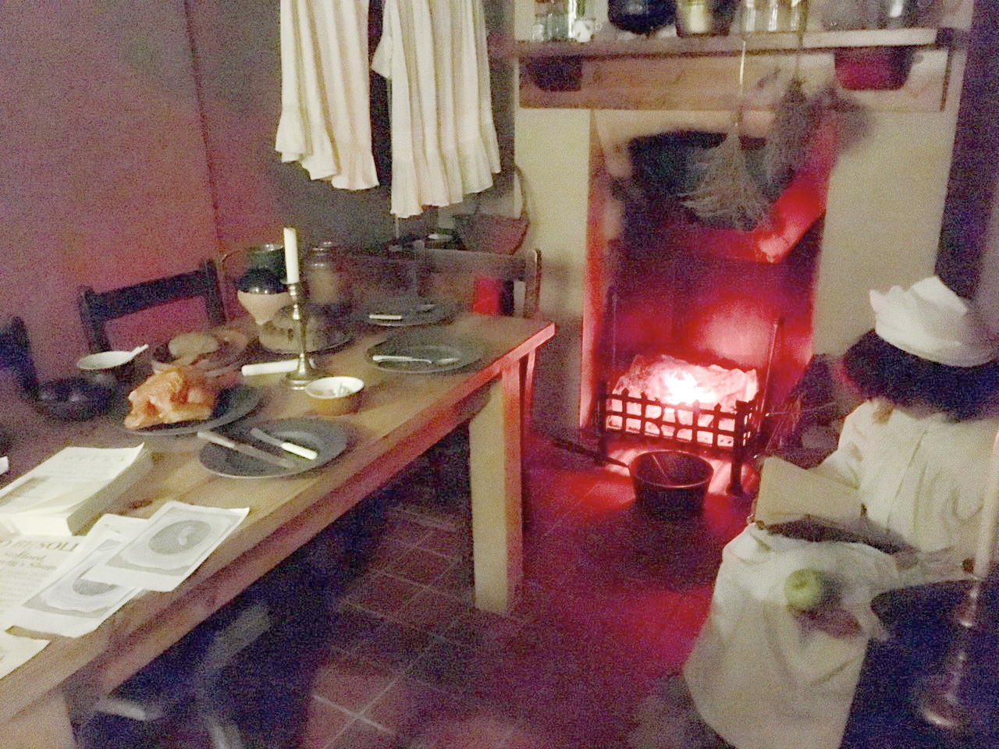

Slide 30
Richard Steele and Joseph Addison
Richard Steele (1672-1729) and Joseph Addison (1672-1719) worked together in producing "The Tatler", a paper of essays on various subjects. These essays, written in pure English prose without too much ‘ornament, helped towards the production of the novel; for they described the actions of imaginary characters, such as Sir Roger de Ceverly, who became a great favorite among readers.
Addison and Steele were mild; Jonathan Swift was bitter satirist. At this time there was a fierce argument about the abilities and the books of the ancients and the moderns. In this battle of the books Swift supported his friend Temple by writing "The Battle of the Books" (1704) on the side of the ancients. His "Tale of a Tub" (кадка) (1704) attacked religious ideas, and annoyed a large number of readers. Swift's famous satire, "Gulliver's Travels" (1726), is in 4 books. As a story it is popular with the young.

Slide 31
Samuel Pepys and John Evelyn
Samuel Pepys [pi:ps] (1632-1704) wrote a well-known diary which opens on January 1st, 1660 and ends on May 31st 1669, when his eyesight began to fail. The diary was written in secret signs, and remained unread at a Cambridge college until 1825, when it was successfully read. It is interesting and important; it gives details of many events of the life of that time. The character of the Pepy's himself, as shown by his diary, is very attractive.
Another diarist, John Evelyn (1620-1706), describes his travels in Europe, and writes about the men of his own time. The diary was first published in 1818. Evelyn also wrote several books on art and trees. Like biographies, diaries became a form of literature.

Slide 32
Edward Gibbon and Edmund Burke
Edward Gibbon decided to write "The Decline and Fall of the Roman Empire" while he was making a tour to Italy in 1764. This is recognized as the greatest historical work in English literature. It covers the events of 13th century. It is clear and complete and usually correct.
Edmund Burke wrote fine prose too, but it was oratorical prose. He was a lawyer and a member of Parliament. He argues that wise government must not press its rights too hard. Later in his life his "Reflections on the French Revolution" (1790) made him famous in all parts of Europe. Burke made many other speeches. He wanted to get rid of slavery. He attacked Warren Hastings after Hastings left India in 1785. He often spoke on Parliamentary affairs.

