Slide 1
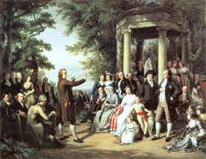
THE AGE OF ENLIGHTENMENT

Slide 2
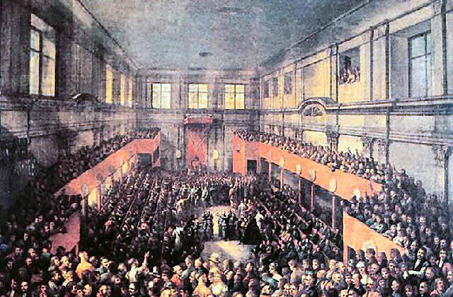
It was a cultural movement of intellectuals beginning in the late 17th and 18th century Europe emphasizing reason and individualism rather than tradition.

Slide 3
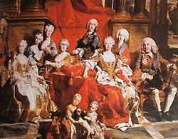
Its purpose was to reform society using reason, challenge ideas grounded in tradition and faith, and advance knowledge through the scientific method. It promoted scientific thought, skepticism, and intellectual interchange.

Slide 4
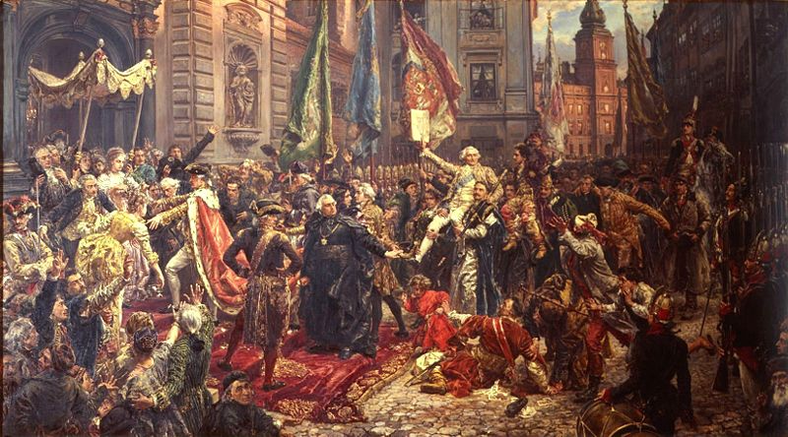
The characteristic features of the movement (which spread all over the Europe) were:
Rejection of Church dogmas;
Love of freedom, striving for systemic education for all;
Concern for the fate of the common people

Slide 5
ENGLISH LITERATURE of that period may be characterized by:
The rise of the political pamphlet and essay; the leading genre – the novel;
The hero of the novel was no longer a prince but a representative of the middle class;
The character is instructive.

Slide 6
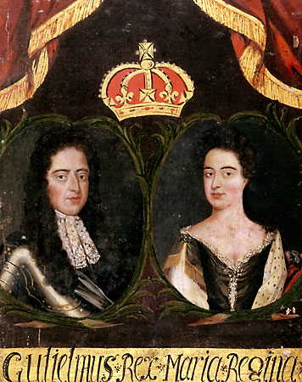
The literature of the period may be divided into 3 periods:
Glorious revolution
(1688-1689)

Slide 7
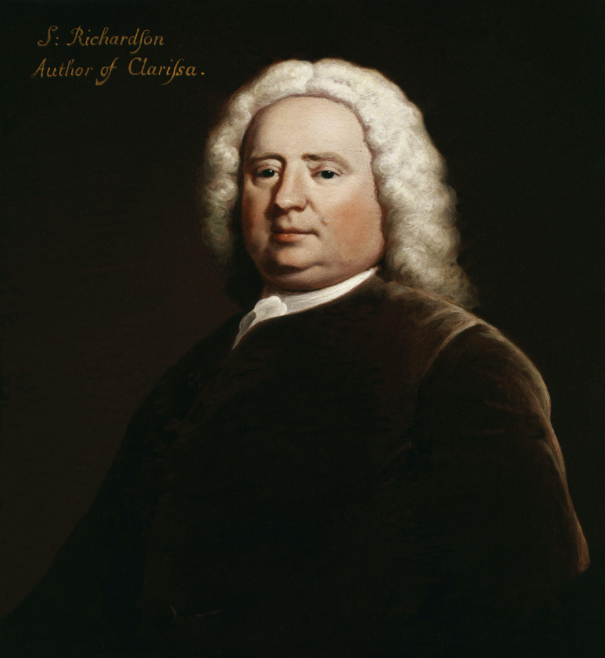
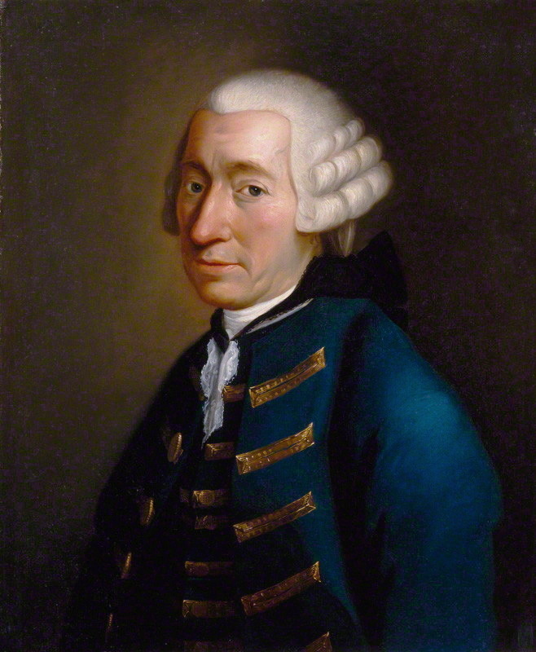
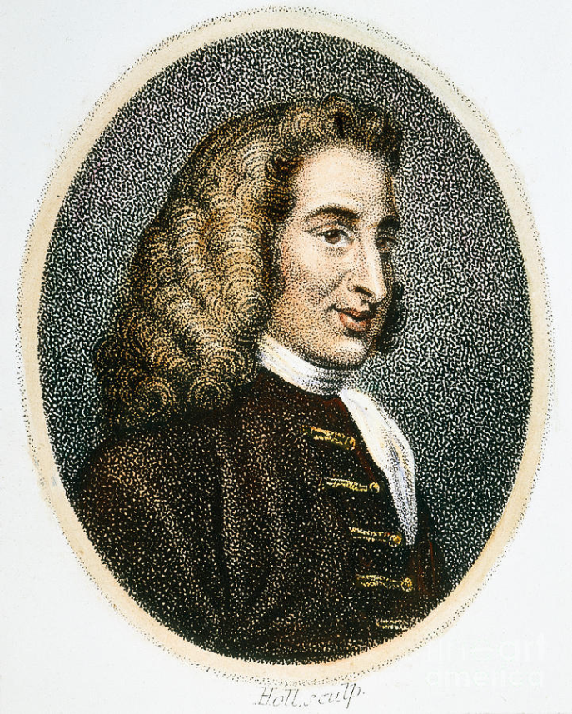
The development of the realistic social novel (1740-1750)
The representatives are

Slide 8
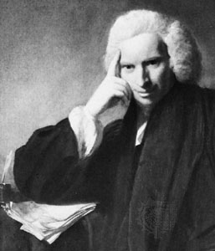
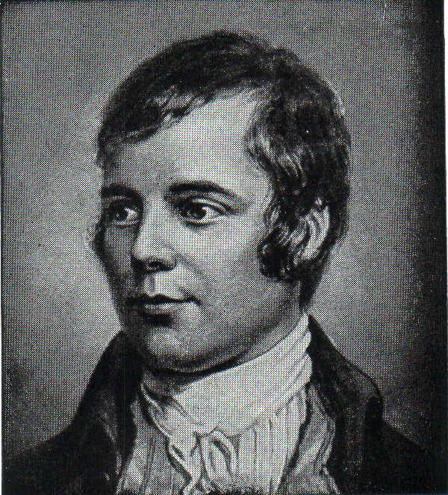
Sentimentalism – (last decades of the century)
L.Sterne R.Burns

Slide 9
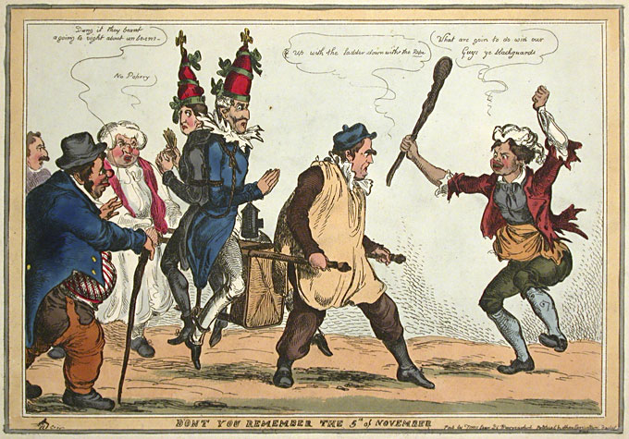
It was also the age of satire. A tradition of verse satire runs through J.Donne’s poems and B.Johnson’s “Comedies of Humours” but the art of satire is now more associated with the period 1660-1750, when it was frequently more social and personally – directed in its attacks.

