Slide 1
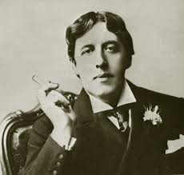
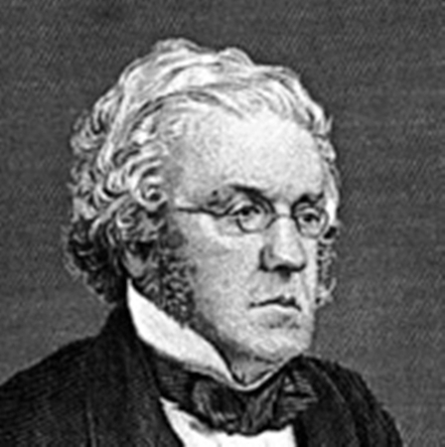
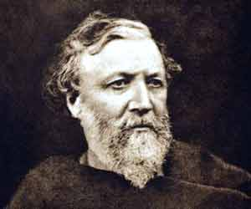
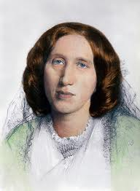
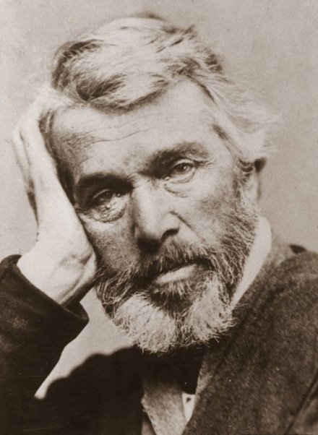
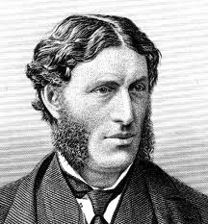
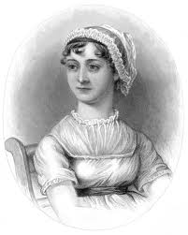
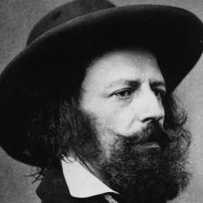
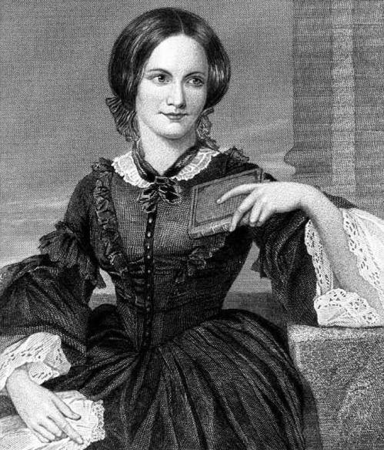
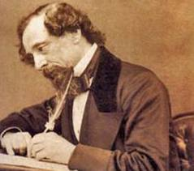
VICTORIAN LITERATURE

Slide 2
CONTENTS
THE VICTORIAN PERIOD: SOCIAL AND CULTURAL CONTEXTS
- The British Empire
- The Industrial Revolution
The Impact of the Industrial Revolution
I. The Emergence of Overcrowded Cities
II. Child Labor
- Cultural Context: Smith, Darwin, and Mill
LITERATURE
- Literature of Social Protest
- The Victorian Novel
- Victorian Poetry
- Victorian Drama

Slide 3
THE VICTORIAN ERA: SOCIAL AND CULTURAL CONTEXTS

Slide 4
THE VICTORIAN PERIOD
The Victorian era of British history was the period of Queen Victoria's reign from 1837 until her death in 1901. It was a long period of peace, prosperity, refined culture, great advancements in technology, and national self-confidence for Britain. During the Victorian age, Britain was the world's most powerful nation. By the end of Victoria's reign, the British empire extended over about one-fifth of the earth's surface. Like Elizabethan England, Victorian England saw great expansion of wealth, power, and culture. But as Victorian England was a time of great ambition and grandeur, it was also a time of misery, squalor, and urban ugliness.

Slide 5
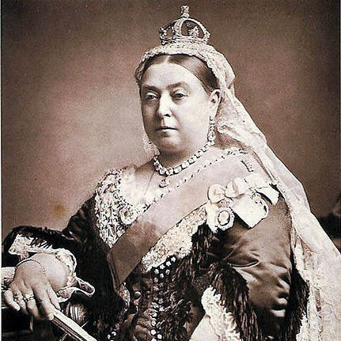
Queen Victoria (1837- 1901)

Slide 6
THE BRITISH EMPIRE
Queen Victoria ruled over a vast and expanding empire, over which, it was said, the sun never set. The British considered the empire as a means of fulfilling the white man’s mission of civilizing the nations under their control and spreading Western values throughout the whole world.

Slide 7
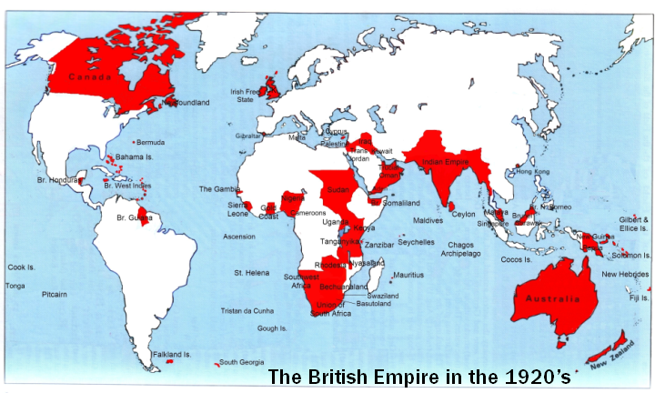

Slide 8
THE INDUSTRIAL REVOLUTION
It started at the end of the eighteenth century, when theoretical knowledge and practical technology were connected. Scientific ideas were applied to the making of machines that transformed the way things were made and dramatically changed people’s lifestyles. A formerly agricultural nation was now based on urban and industrial growth. But as industry grew, it was accompanied by a rapid increase in the numbers of the urban working-class poor. Workers in the cities lived in miserable conditions. Urban squalor and misery were signs of a massive change in the English society.

Slide 9
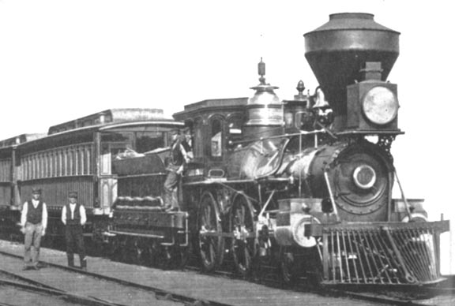
The Age of Steam

Slide 10
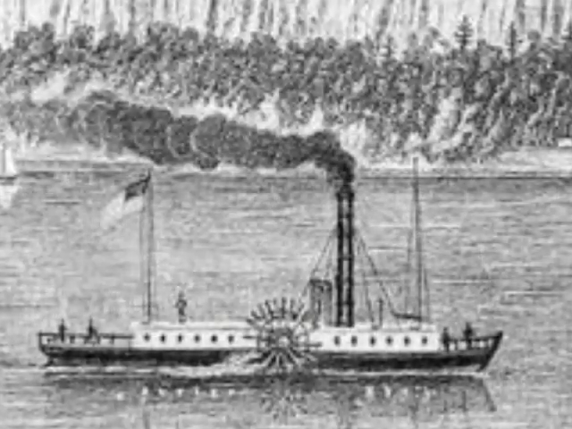

Slide 11
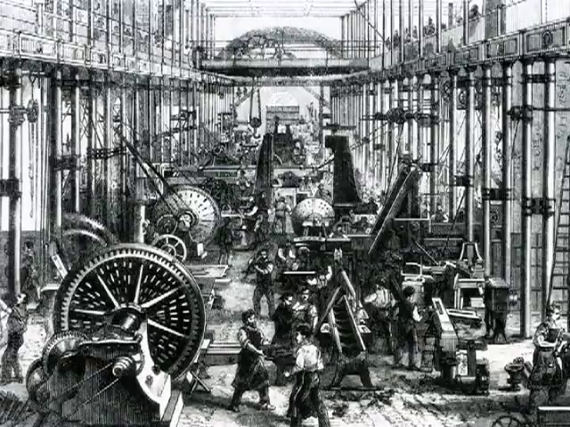
Mass Production

Slide 12
The Impact of the Industrial Revolution
I. The Emergence of Overcrowded Cities
One result of the advance of technology was the unprecedented growth of cities. People, in search of work left the countryside to work in factories in the different cities of Britain. They had to live in very dirty and unhealthy conditions. There were too many workers and not enough houses. People were living like animals. Diseases raged, hunger, poverty, and deprivation prevailed, crime accelerated, and misery increased.

Slide 13
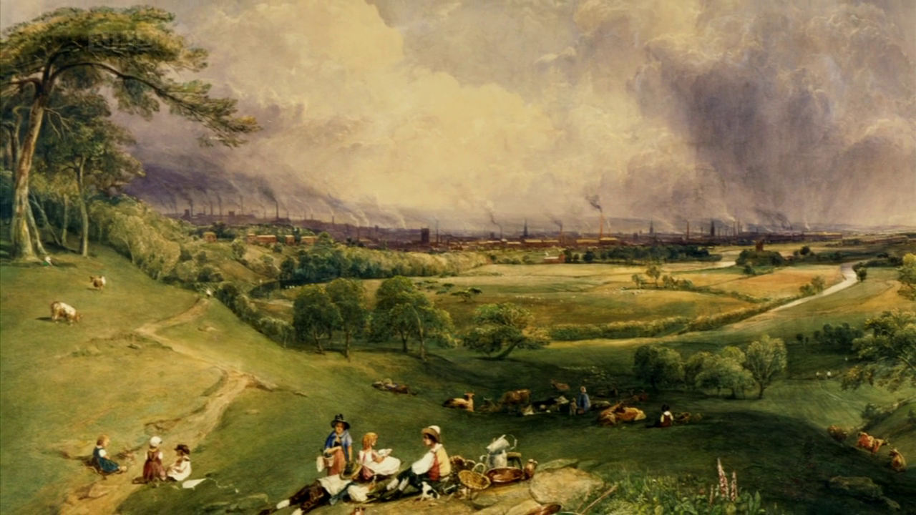
The old rural social pattern was receding under the impact of harsh industrialization

Slide 14
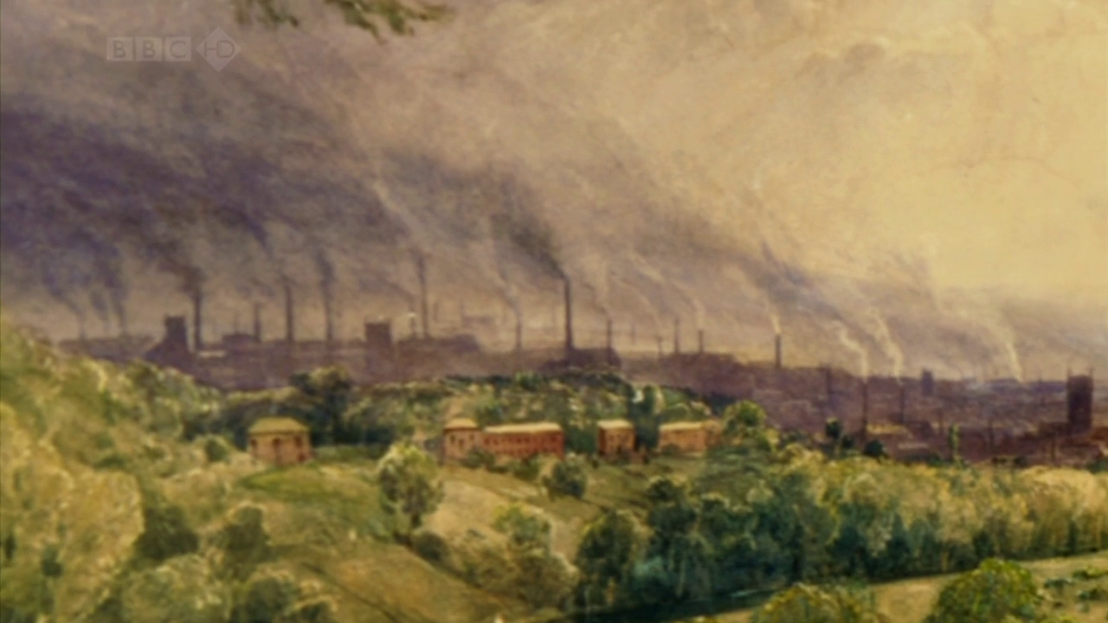

Slide 15
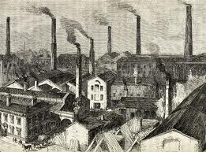

Slide 16
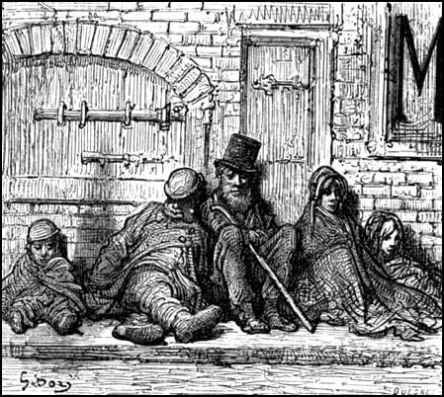
Gustav Doré

Slide 17
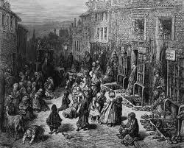

Slide 18
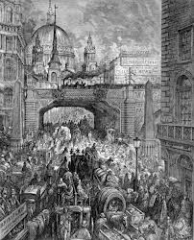

Slide 19
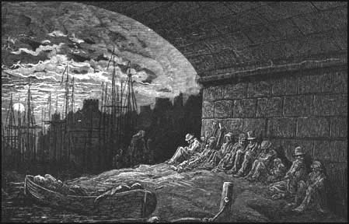

Slide 20
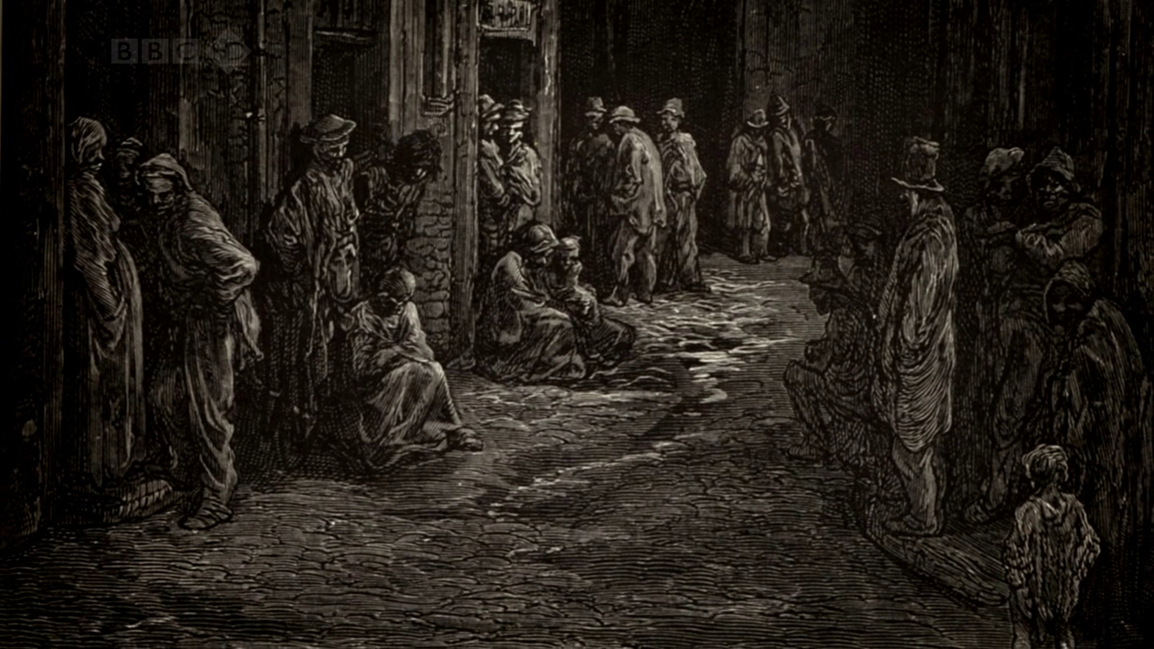

Slide 21
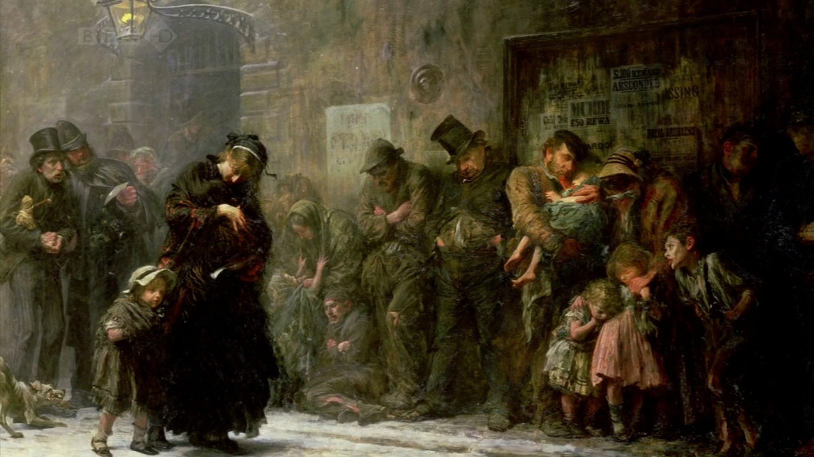
The homeless waiting for admission into a workhouse are depicted in this picture by Luke Fildes
Applicants for Admission to a Casual Ward Luke Fildes, 1874.

Slide 22
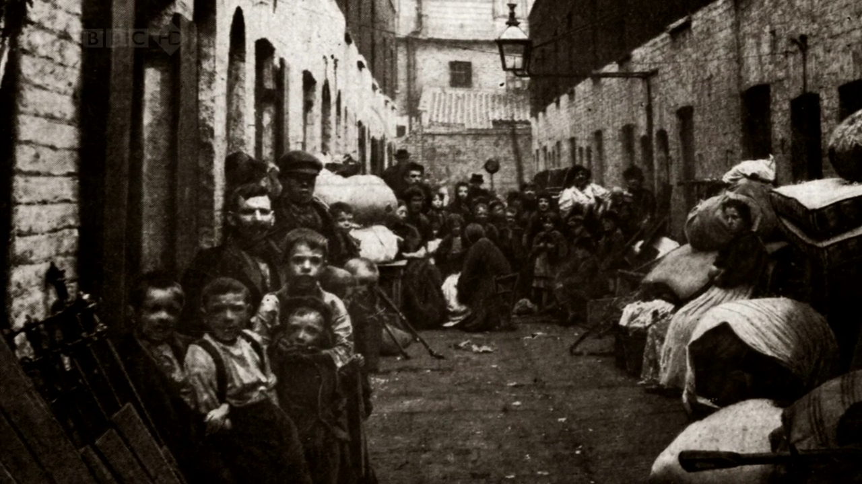

Slide 23
II. Child Labor
Children were expected to help to support their families. They often worked long hours in dangerous jobs and in difficult situations for very little wages. For example, there were the climbing boys employed by the chimney sweeps, the little children who could scramble under the moving machinery to retrieve the cotton fluff; boys and girls working down the coal mines, crawling through tunnels too narrow and low to take an adult.

Slide 24
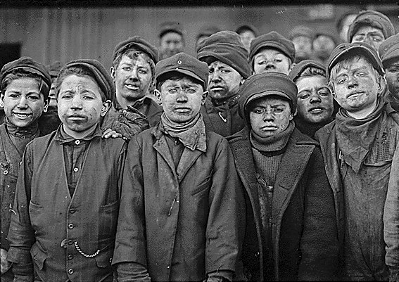

Slide 25
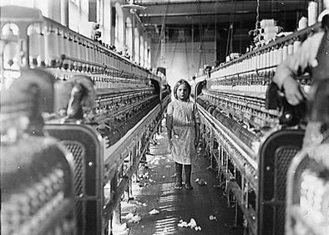

Slide 26
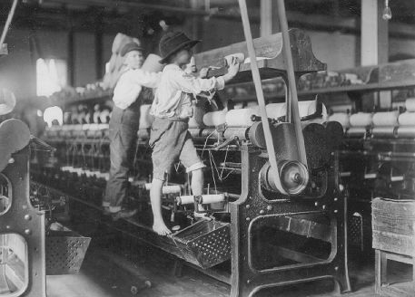

Slide 27
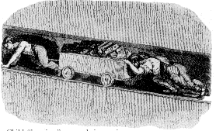

Slide 28
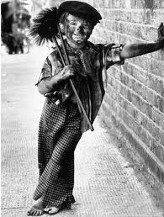
Chimney Sweeper

Slide 29
CULTURAL CONTEXT
ADAM SMITH: Smith’s economic ideas had great influence on Victorian thinking. In The Wealth of Nations (1776), advocated free trade and believed that the market is best left untouched. Government intervention only prevents the economy from righting itself. He therefore strongly opposed any government interference with business affairs. He was against trade restrictions and minimum wage laws as being harmful to a nation's economy. This laissez-faire policy of government non-intervention remained popular throughout the Victorian Era. Capitalists often twisted his words to oppose child labor laws, maximum working hours, and factory health codes.
CHARLES DARWIN: Darwin’s theory of evolution, proposed in his book The Origin of Species (1859), has transformed the way we think about the natural world. The book was extremely controversial because it implied that man was simply another form of animal and that people might have evolved from apes. Darwin was strongly attacked, particularly by the Church. The theory of evolution led to a crisis of faith and spiritual doubt among so many people.
JOHN STUART MILL: Mill was a champion of individual rights in his book On Liberty (1869), and a pioneer of women’s rights in The Subjection of Women (1869). Mill attacked the tyranny of the majority who would deny liberty to individuals through public opinion.

Slide 30
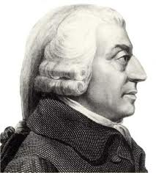
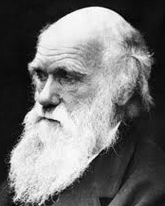
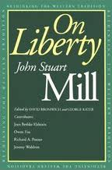
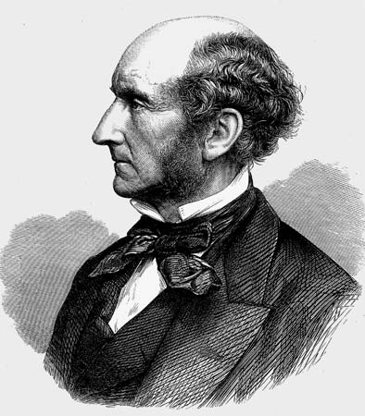
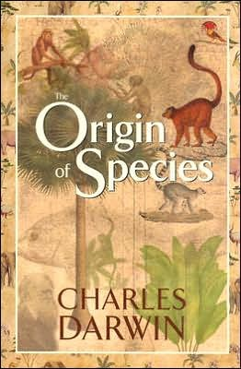
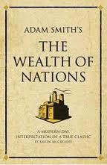
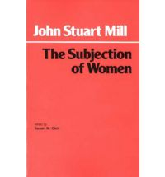

Slide 31
LITERATURE OF SOCIAL PROTEST
The social and cultural background of the period has had a deep impact on literature of the Victorian period. Some works of literature protested the grim reality of the industrial age. Depicting the deplorable conditions in factories and mines, the plight of child labor, the discrimination against women, and other social issues, such literary works were a means of social reform.
Elizabeth Gaskell’s Mary Barton was one of the first novels to warn against the problems of industrialization. Charles Dickens’ works Oliver Twist and Hard Times treated the themes of child abuse, poverty, urban squalor, crime, and corrupt educational systems.

Slide 32
THE VICTORIAN NOVEL
The novel was the dominant genre in the Victorian period. Charles Dickens (1812-1870) created a host of unforgettable characters in such novels as Oliver Twist, Great Expectations, David Copperfield, Hard Times, and A Tale of Two Cities. William Thackeray's (1811-1863) most famous work is Vanity Fair. Charlotte Bronte’s (1816–55) Jane Eyre and Emily Bronte’s (1818–48) Wuthering Heights are classics of English literature. George Eliot's (1819–80) most important works are Middlemarch, The Mill on the Floss and Adam Bede. The major novelist of the later part of the period was Thomas Hardy (1840-1928), whose best works include Tess of the D'Urbervilles, Far from the Madding Crowd, and Jude the Obscure.

Slide 33
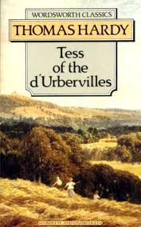
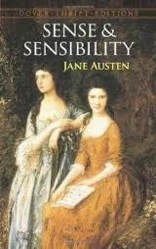
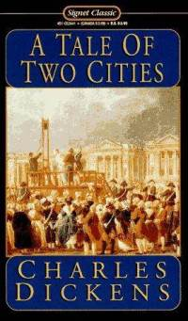
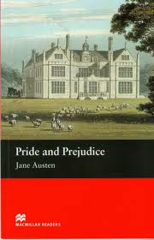
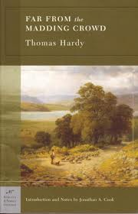
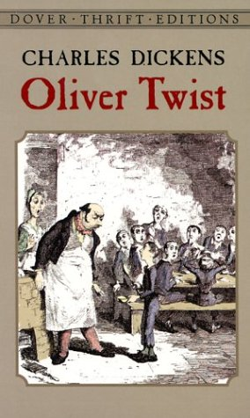
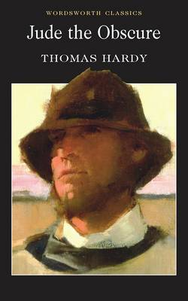
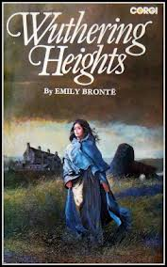
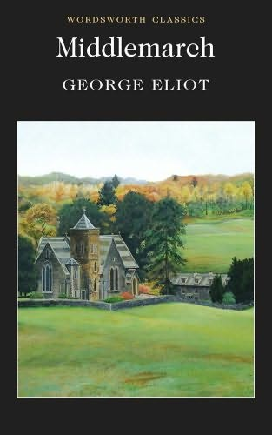
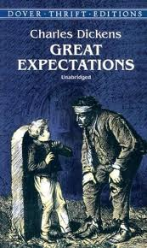
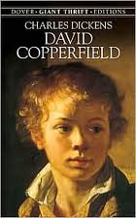
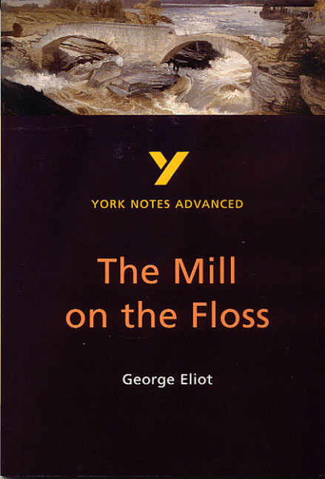
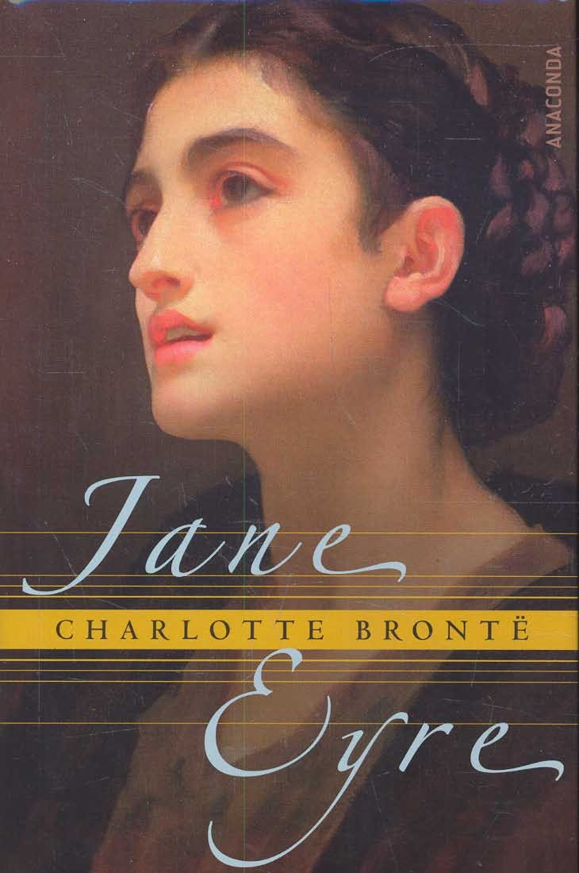

Slide 34
VICTORIAN POETRY
Many characteristics of romantic poetry continued in poetry of the Victorian period.
However, Victorian poetry, in general, is less subjective than the romantic.
An interest in the past, both the classical and the medieval, appears in the subjects, and in the use of mythological and historical allusions.
The dramatic monologue is used greatly by the poets.
The themes are more realistic, discussing such issues as child labor, the rights of women, science and religion.
Victorian poetry is mostly pictorial, heavily relying on visual imagery.
The elegy is one of the most popular poetic forms in the period, a form of poetry that laments the dead or the past.
Victorian poetry is often characterized by doubt and psychological conflicts.
The greatest poets of the period are Alfred Lord Tennyson and Robert Browning. Other important poets are Matthew Arnold, Gerard Manley Hopkins, Christina Rossetti, Elizabeth Barrett Browning. Thomas Hardy is considered the best poet of the late Victorians.

Slide 35
Elizabeth Barrett Browning
Alfred Tennyson
Robert Browning
Thomas Hardy
Gerard Manley Hopkins
Christina Rossetti

Slide 36
VICTORIAN DRAMA
Throughout the nineteenth century, drama continued its decline since the Restoration period. Most works of the period lack depth and originality. Two playwrights are exceptions to this trend: Oscar Wild (1856-1900) and George Bernard Shaw (1856-1950). Oscar Wild’s comedies such as The Importance of Being Earnest and Lady Windermere's Fan abound in verbal polish and cynicism. Shaw’s plays addressed such social questions as education, marriage, and the class system in a comic vein. His works include Man and Superman, Pygmalion, and St. Joan.

Slide 37
Oscar Wilde
(1856-1900)
George Bernard Shaw
(1856-1950)

Slide 38
Ulysses and the Sirens
J. M. W. Waterhouse , 1891

